Slide 1


Balanced Bodies:
Healthy Weight for a Healthy Life
Presented by the American Heart Association
Notes:
“Hi everyone! Today we’re going to talk about balance. Not just balance in sports or games, but balance in our bodies. When we balance what we eat with how much we move, our bodies get stronger and healthier inside and out.”

Slide 2
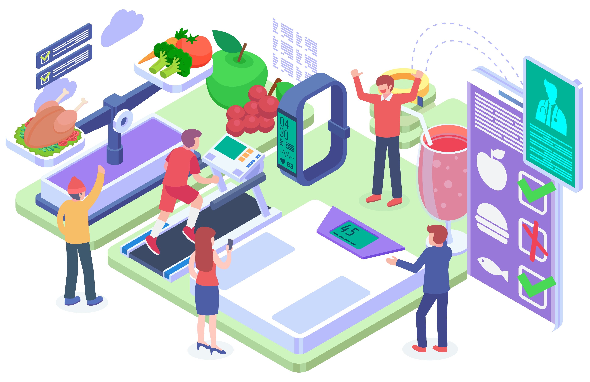
What Does Balance Mean?
Healthy food + activity = strong body
Too much unhealthy food or too little activity = extra weight
Balance helps your heart and organs
Notes:
“Think of balance like a seesaw. When you eat healthy foods and get active, the seesaw is steady. But if there’s too much unhealthy food or too little activity, the seesaw tips. That can lead to extra weight, which puts stress on your heart and organs.”

Slide 3
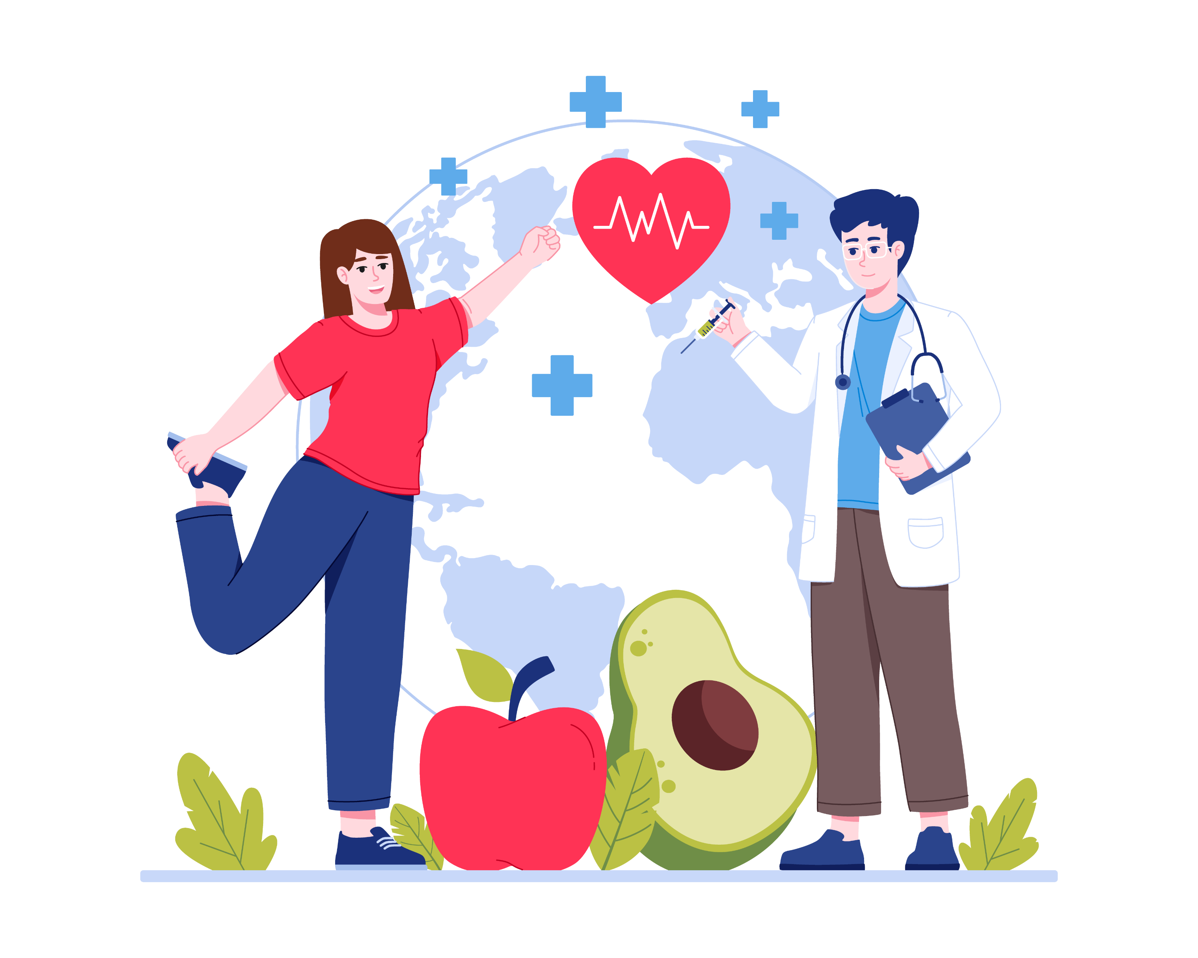
Why It Matters
Extra weight can make us feel unhealthy
Can hurt our heart and organs over time
Healthy weight = healthy inside, not about looks
Notes:
“Having extra weight isn’t just about how you look—it’s about how your body works. Extra weight can make you feel unhealthy and can hurt your heart and organs over time. A healthy weight means your body is working its best.”

Slide 4
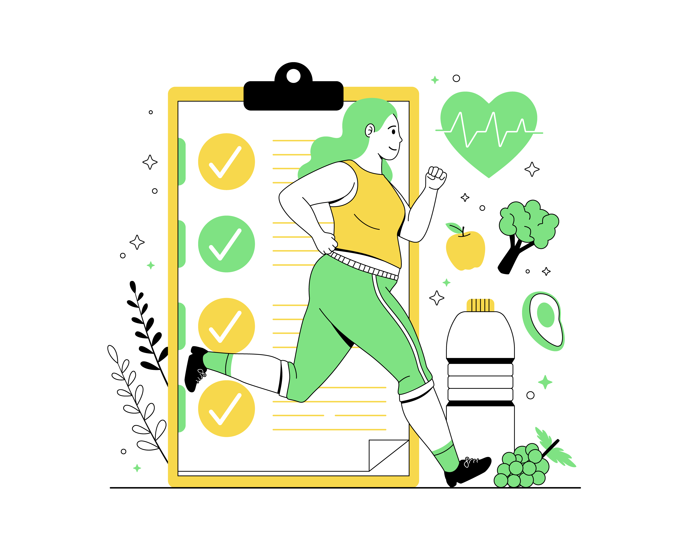
Quiz #1: Healthy weight is about how you look on the outside.
True
False
Notes:
Quiz #1
“Let’s test what we’ve learned. True or False: Healthy weight is about how you look on the outside.”
[Pause for answers]
Answer: False. “It’s about how healthy your body is on the inside.”

Slide 5
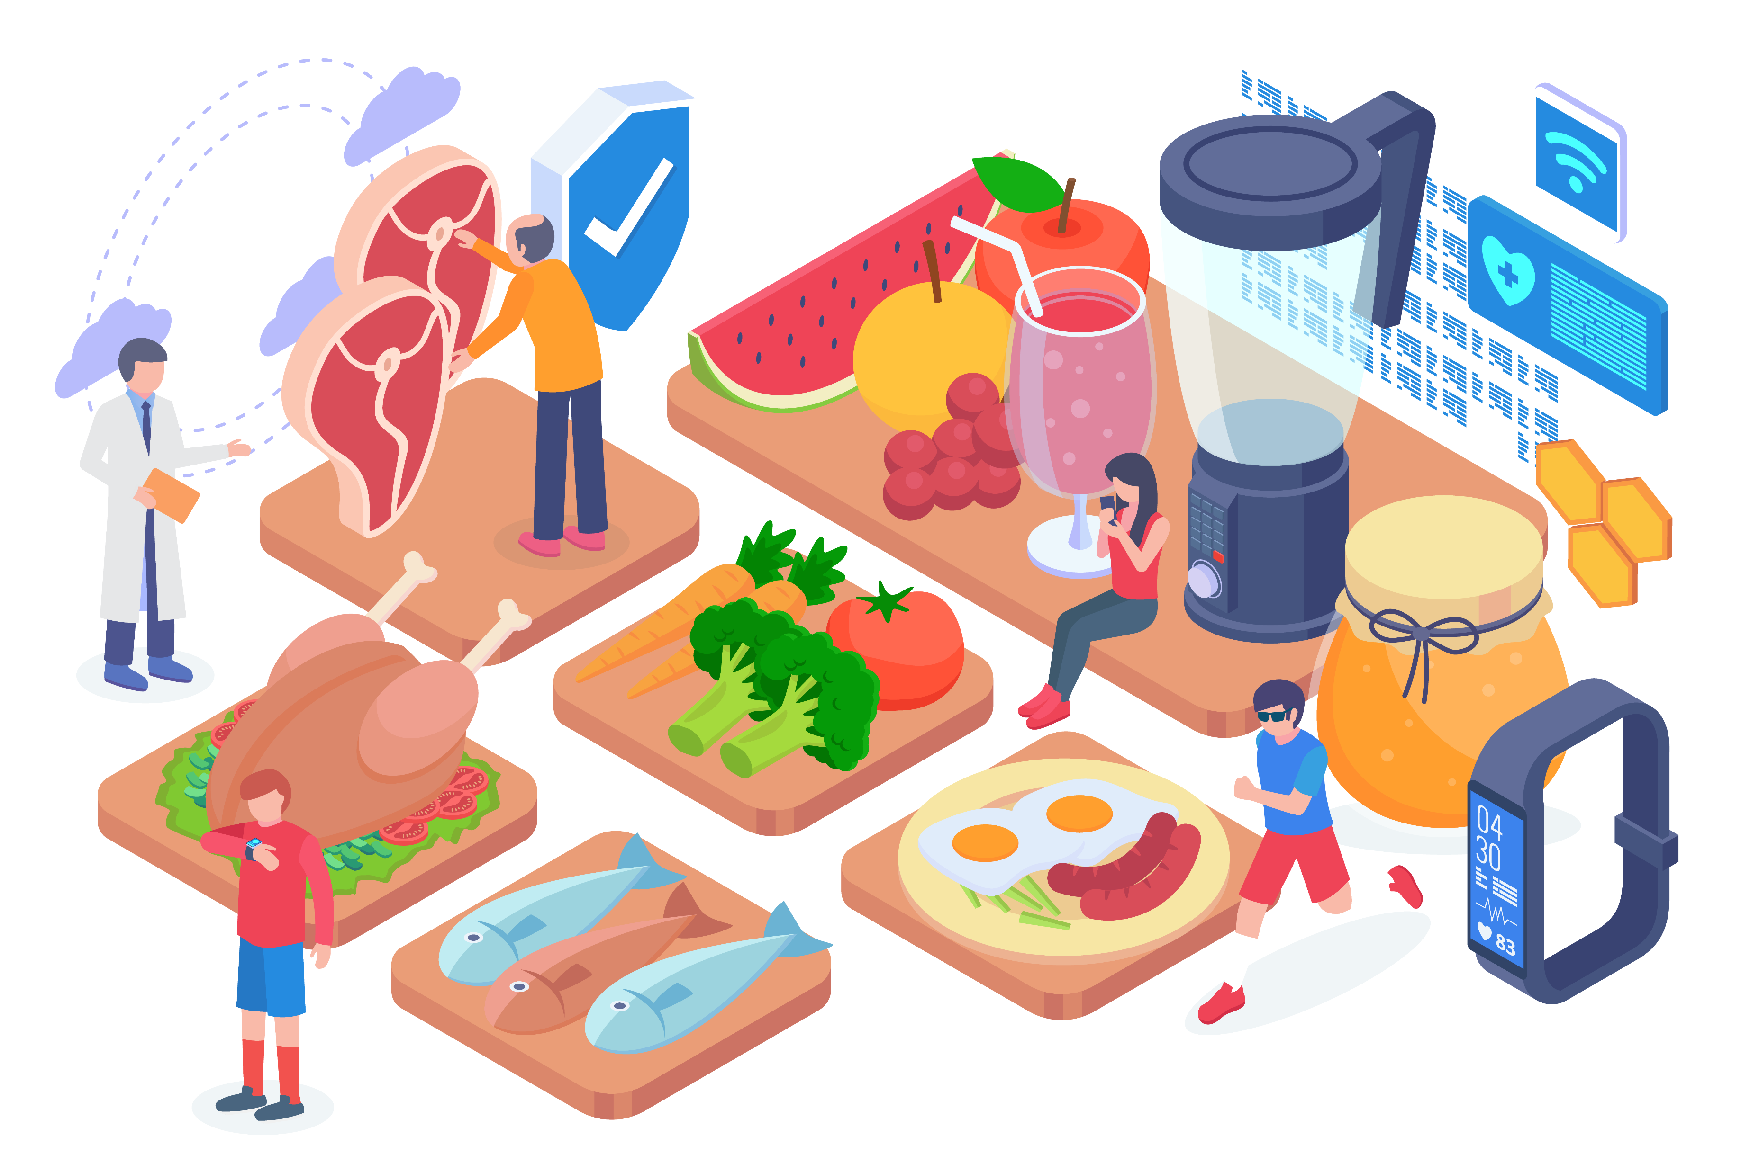
Balanced Eating
Eat a mix: proteins, carbs, veggies, fruits
Provides energy to stay active
Listen to your hunger cues
Notes:
“Eating balanced meals is like creating a winning team. Proteins, carbs, veggies, and fruits all play a role in keeping you strong and energized. Try to make your plate colorful—different foods give your body different powers.”

Slide 6
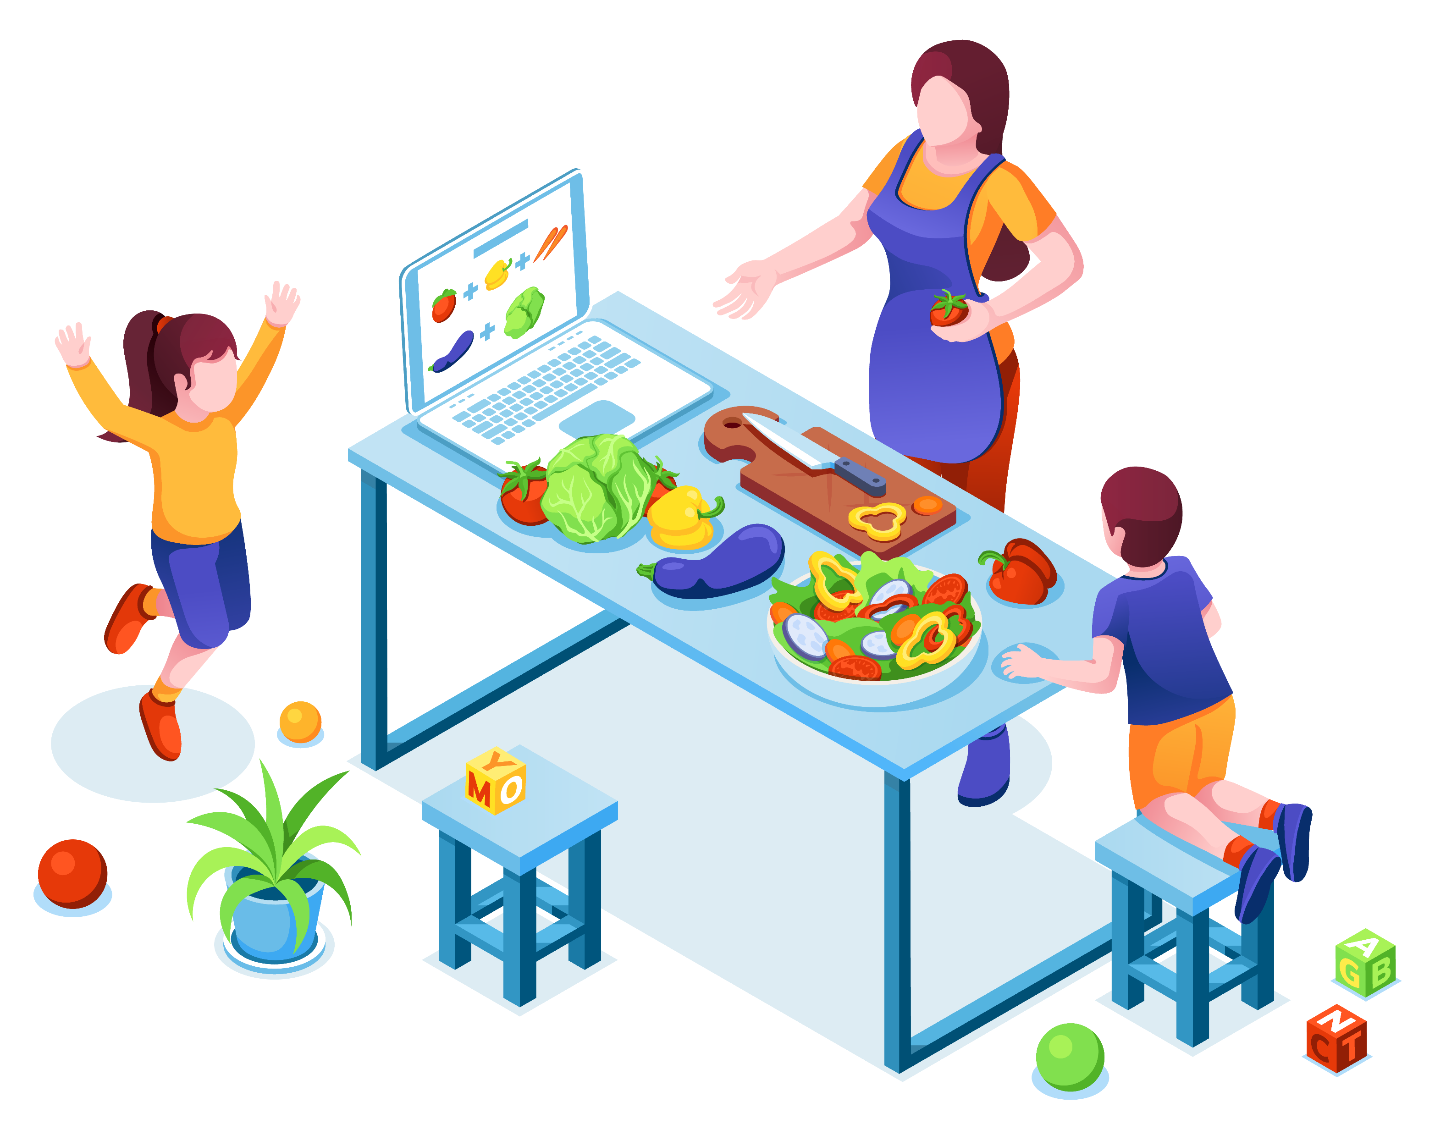
Quiz #2: Which of these is a balanced meal?
Candy and soda
Chicken, rice, and vegetables
Chips and juice
Notes:
Quiz #2
“Which of these is a balanced meal?
a) Candy and soda
b) Chicken, rice, and vegetables
c) Chips and juice”
[Pause for answers]
Answer: b – Chicken, rice, and vegetables.

Slide 7
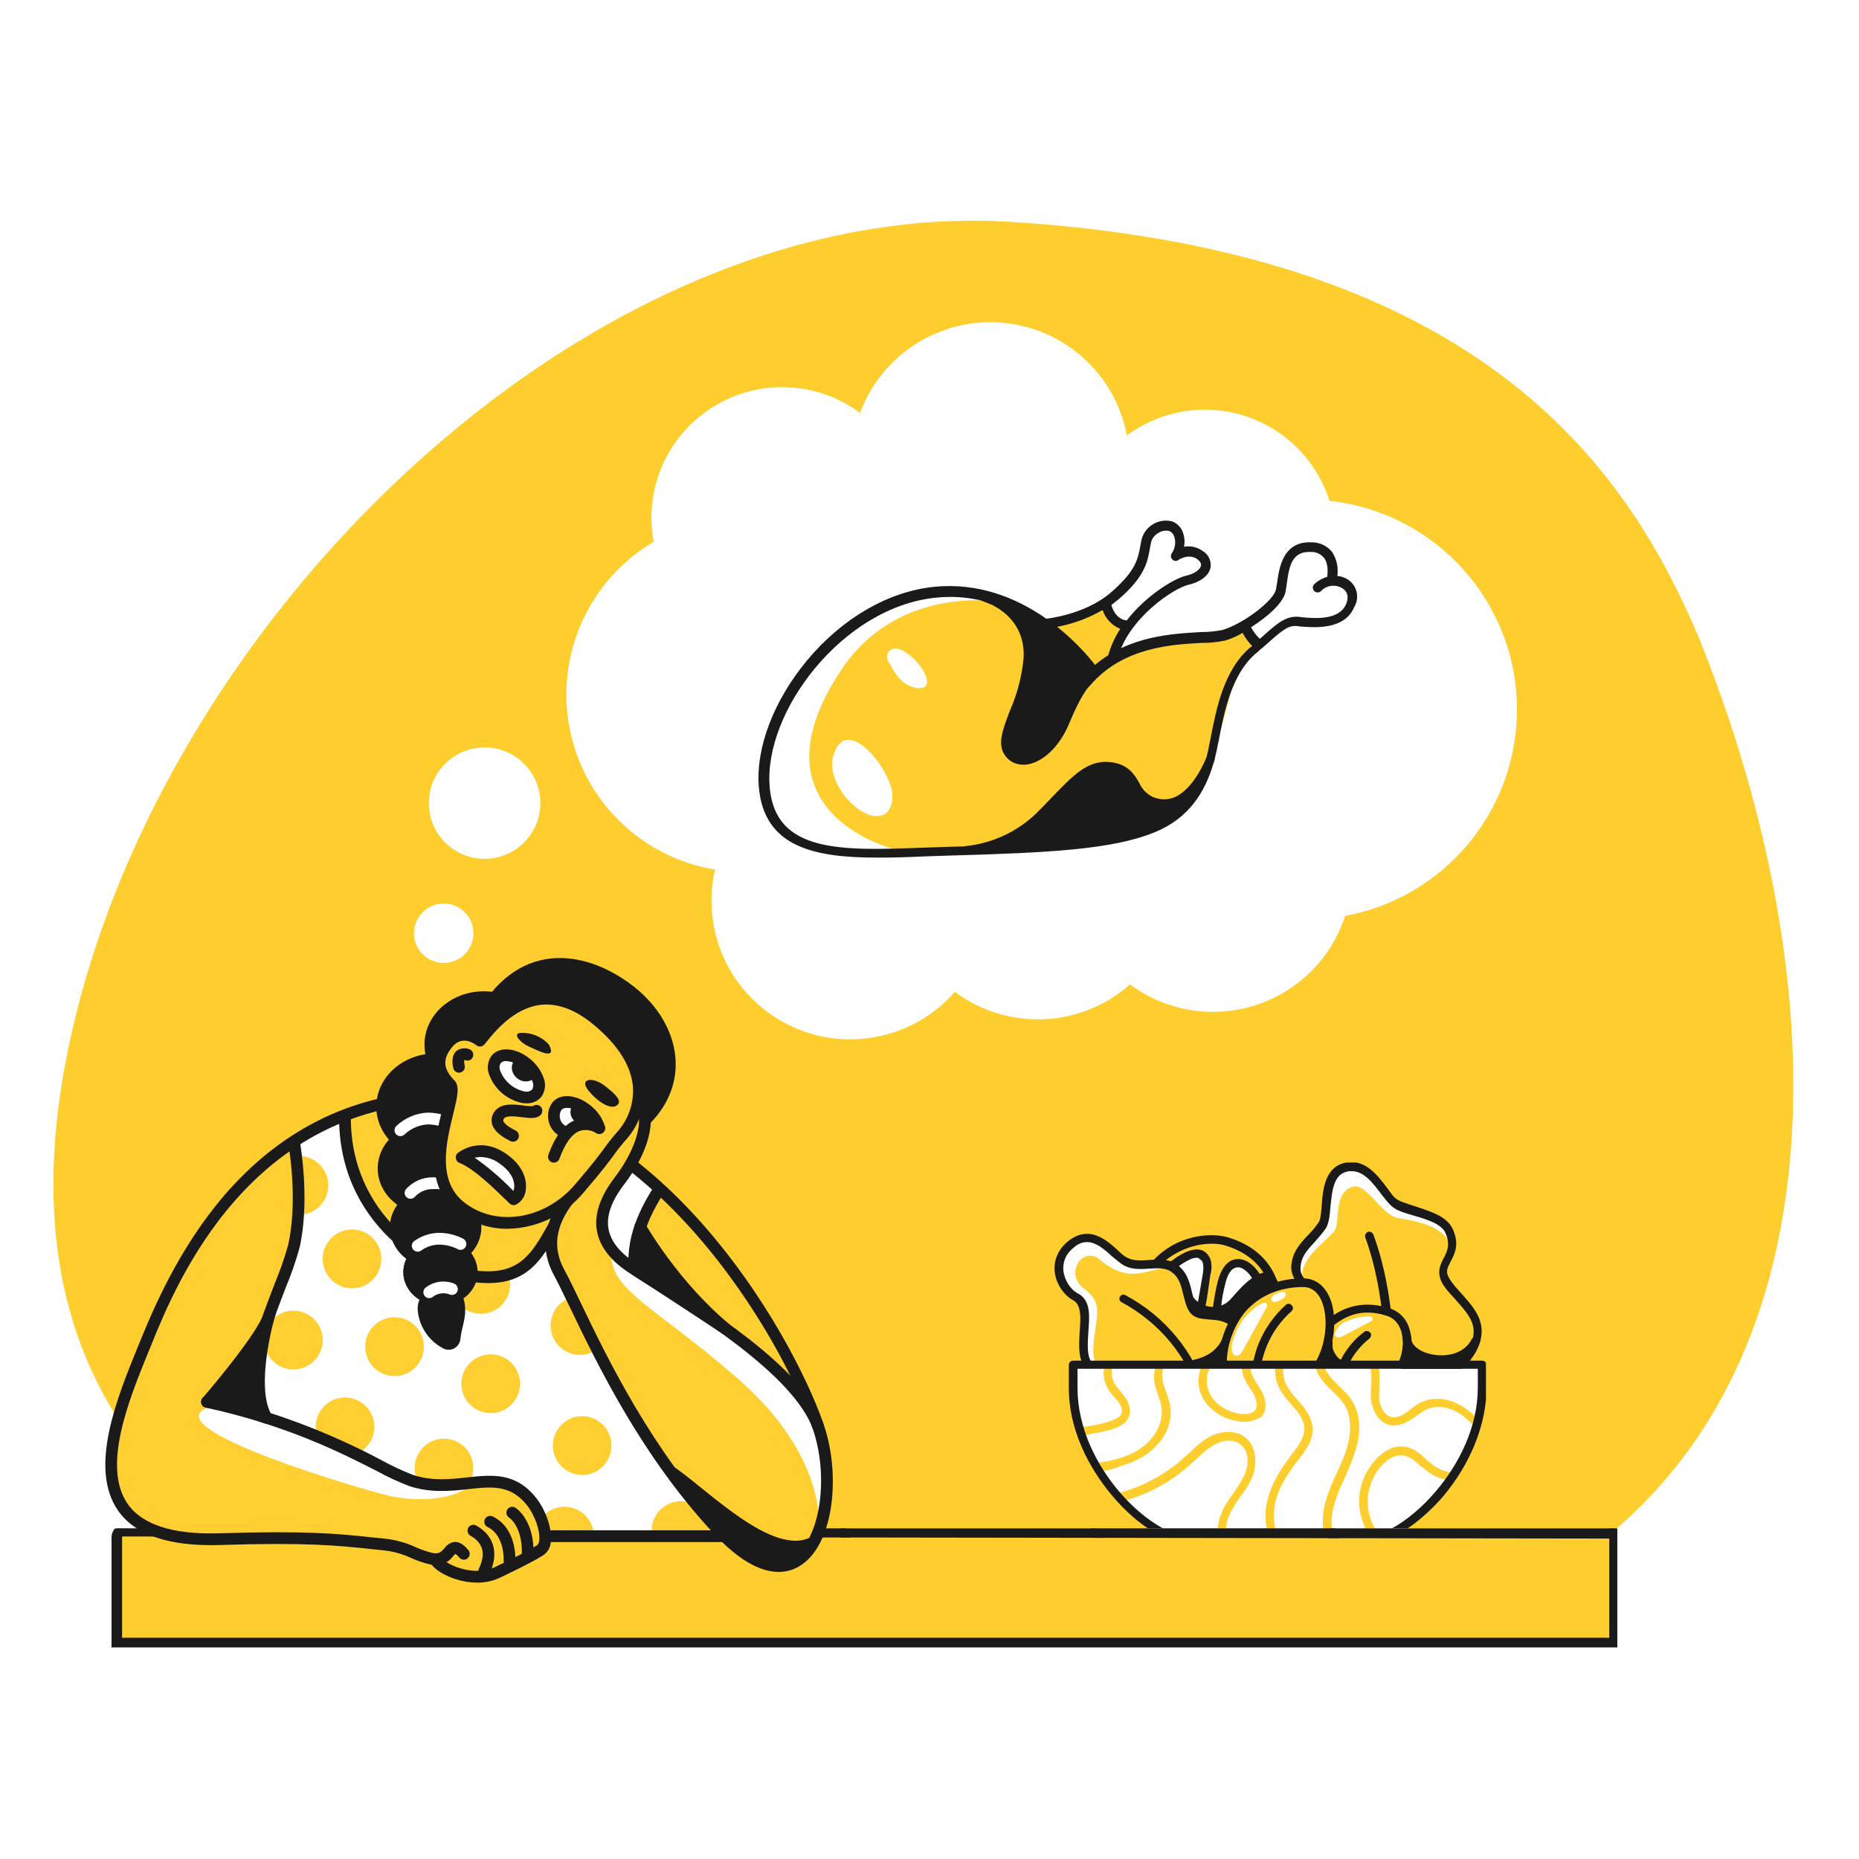
Eat Mindfully
Eat when hungry, stop when full
Notice if you’re eating from stress or boredom
Notes:
“Balance isn’t only about what you eat, but also how. Eat when you’re hungry, stop when you’re full. And check in with yourself—sometimes we eat because we’re bored or stressed, not because we’re hungry.”

Slide 8
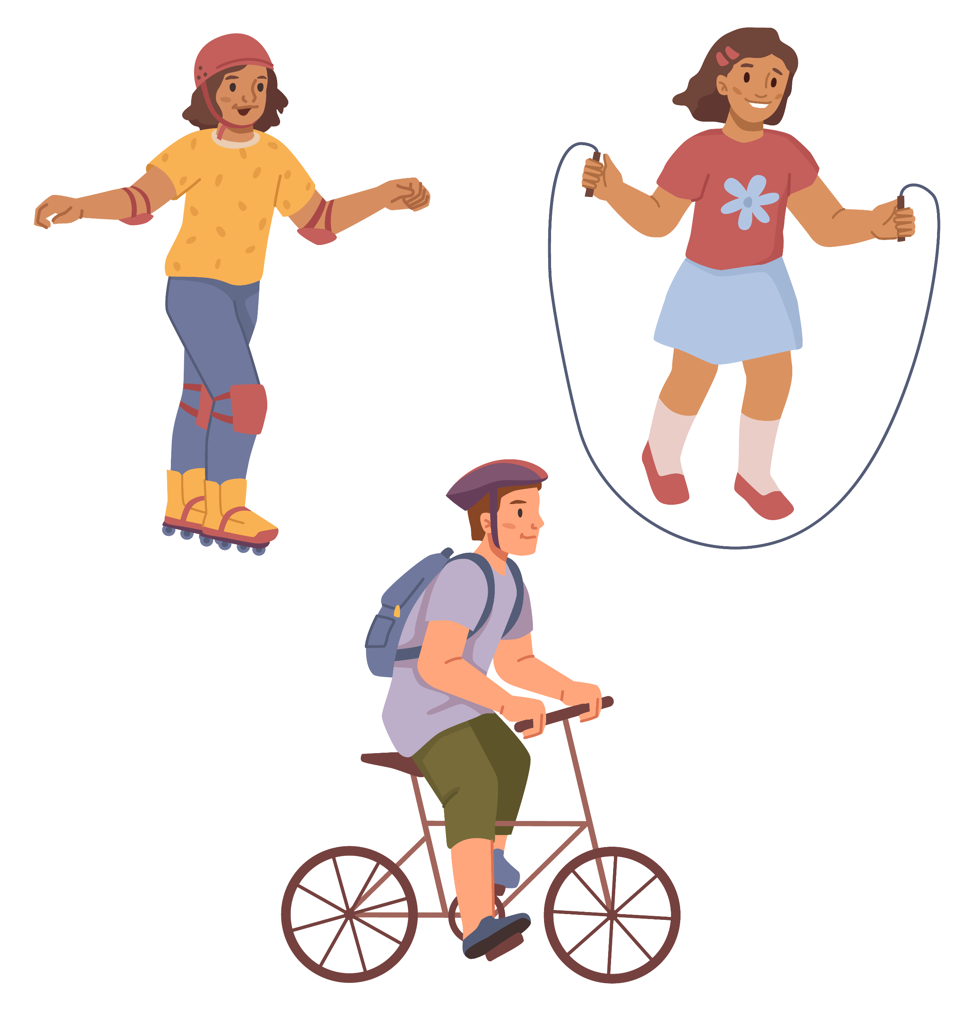
Daily Movement
At least 60 minutes of activity every day
Sports, play, dancing, biking all count
Notes:
“Food gives you fuel, but you also need to move your body every day. At least 60 minutes of activity is recommended for kids and teens. That could be sports, dancing, biking, or just playing outside—it all counts!”

Slide 9
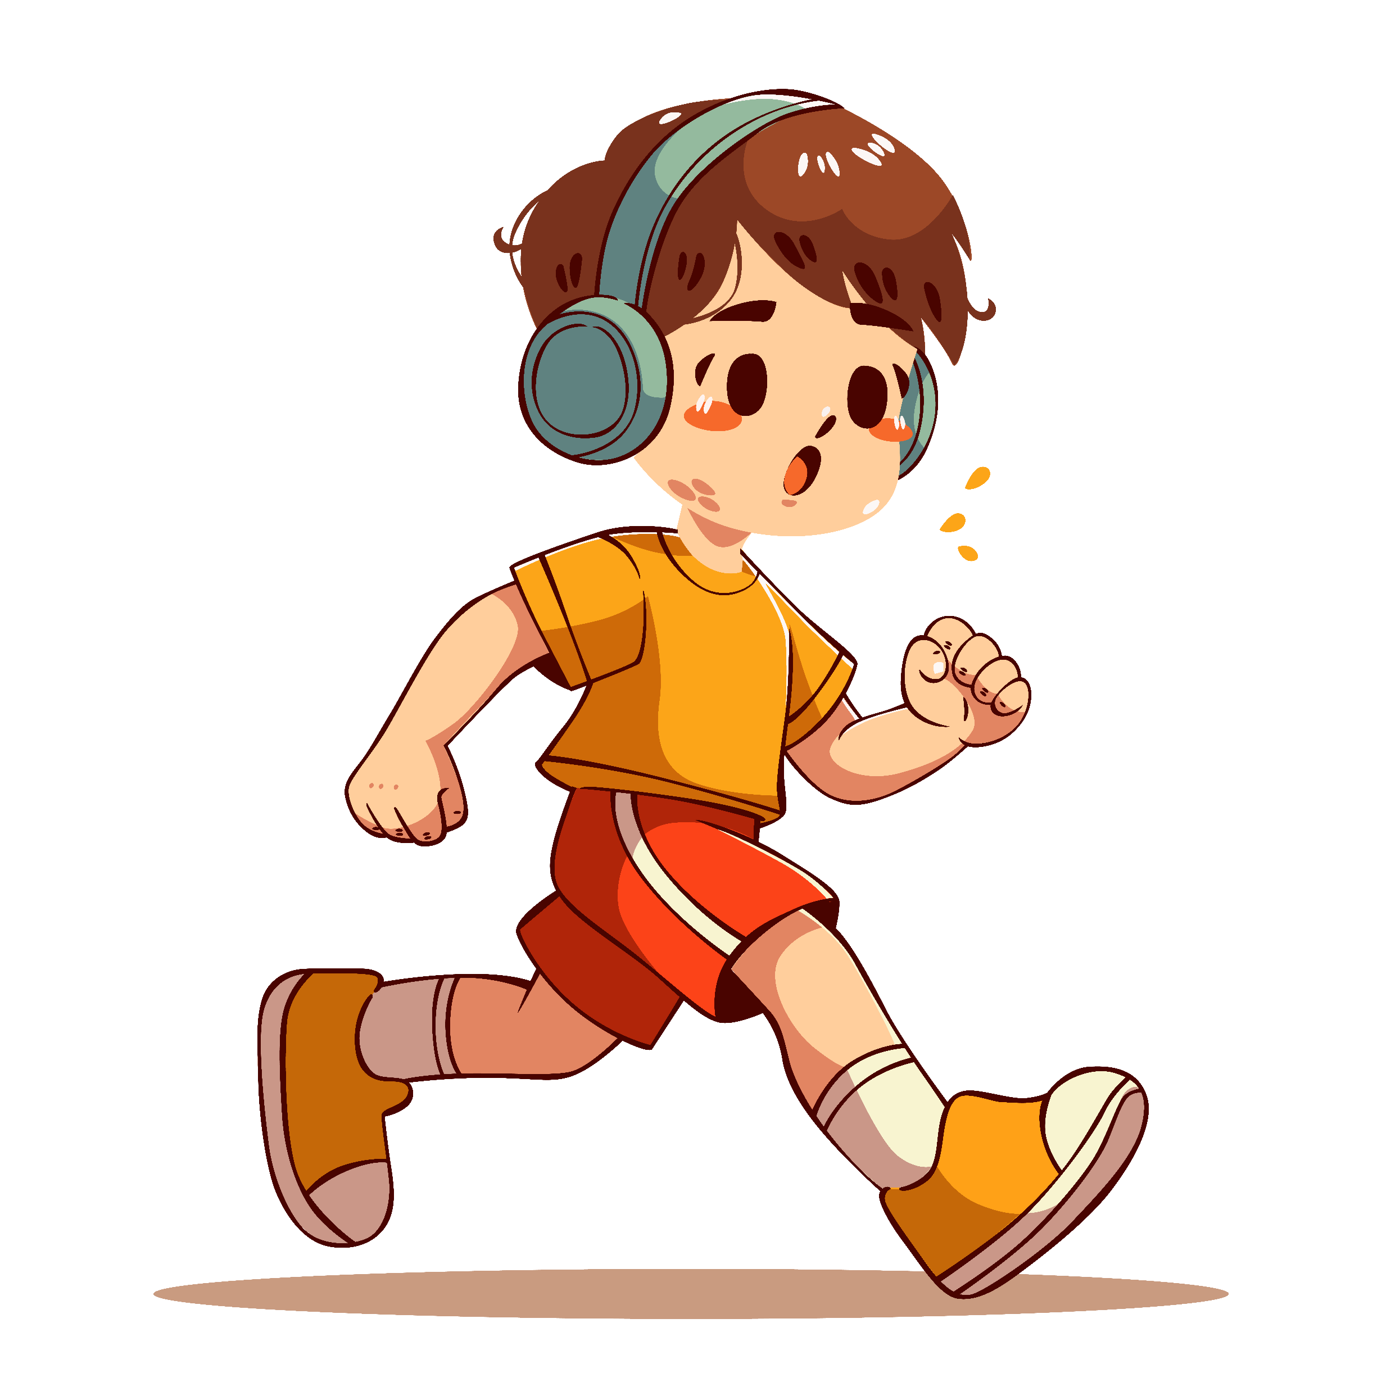
Quiz #3: How many minutes should kids and teens move every day?
30 minutes
60 minutes
90 minutes
Notes:
“How many minutes should kids and teens move every day?
a) 30 minutes
b) 60 minutes
c) 90 minutes”
[Pause for answers]
Answer: b – At least 60 minutes.

Slide 10
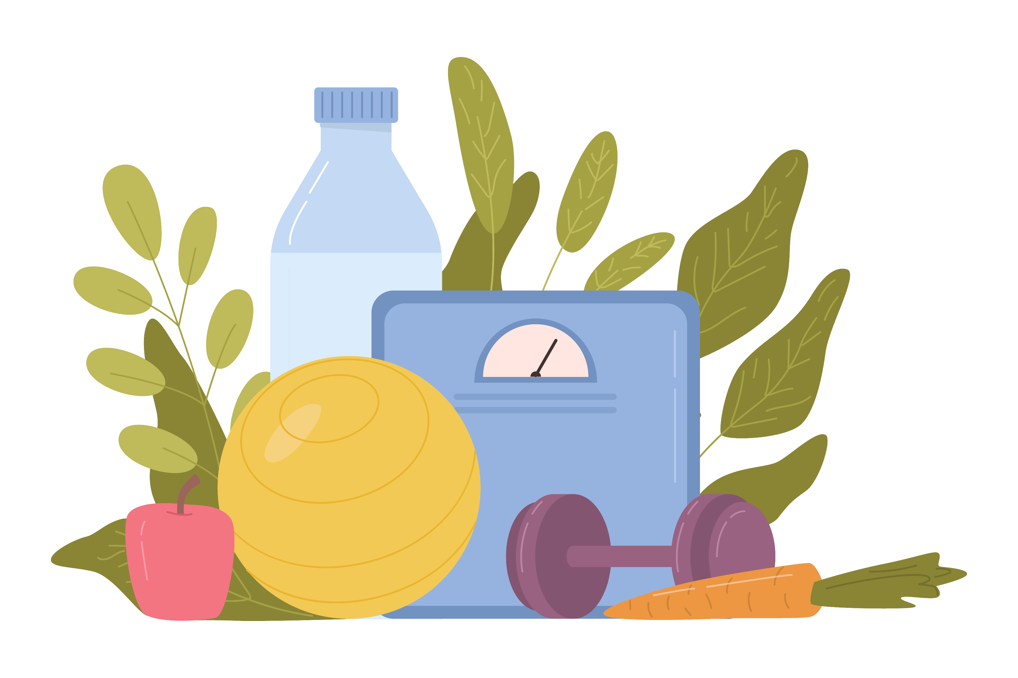
Why Balance
Feels Good
More energy for school, sports, and friends
Stronger heart and body
Builds lifelong healthy habits
Notes:
“When your body is balanced, you have more energy for school, sports, and friends. You get stronger, your heart gets healthier, and you build habits that will last a lifetime.”

Slide 11
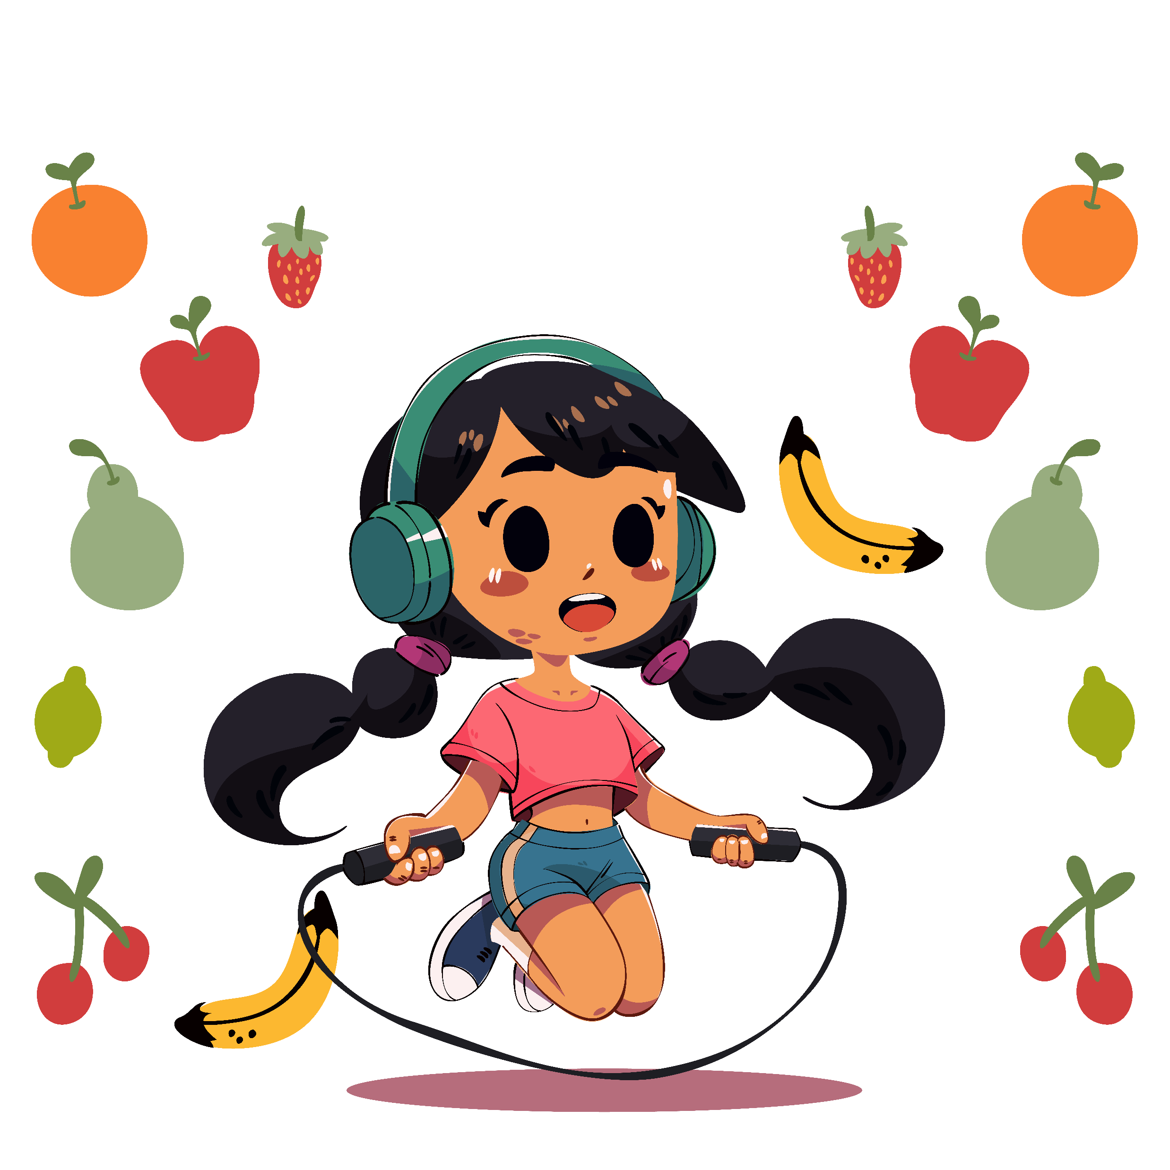
Quiz #4: Fill in the blank: Balance = ________ + ________.
Answer:
Healthy food + Physical activity
Notes:
“Fill in the blank: Balance = ______ + ______.”
Answer: Healthy food + Physical activity.

Slide 12
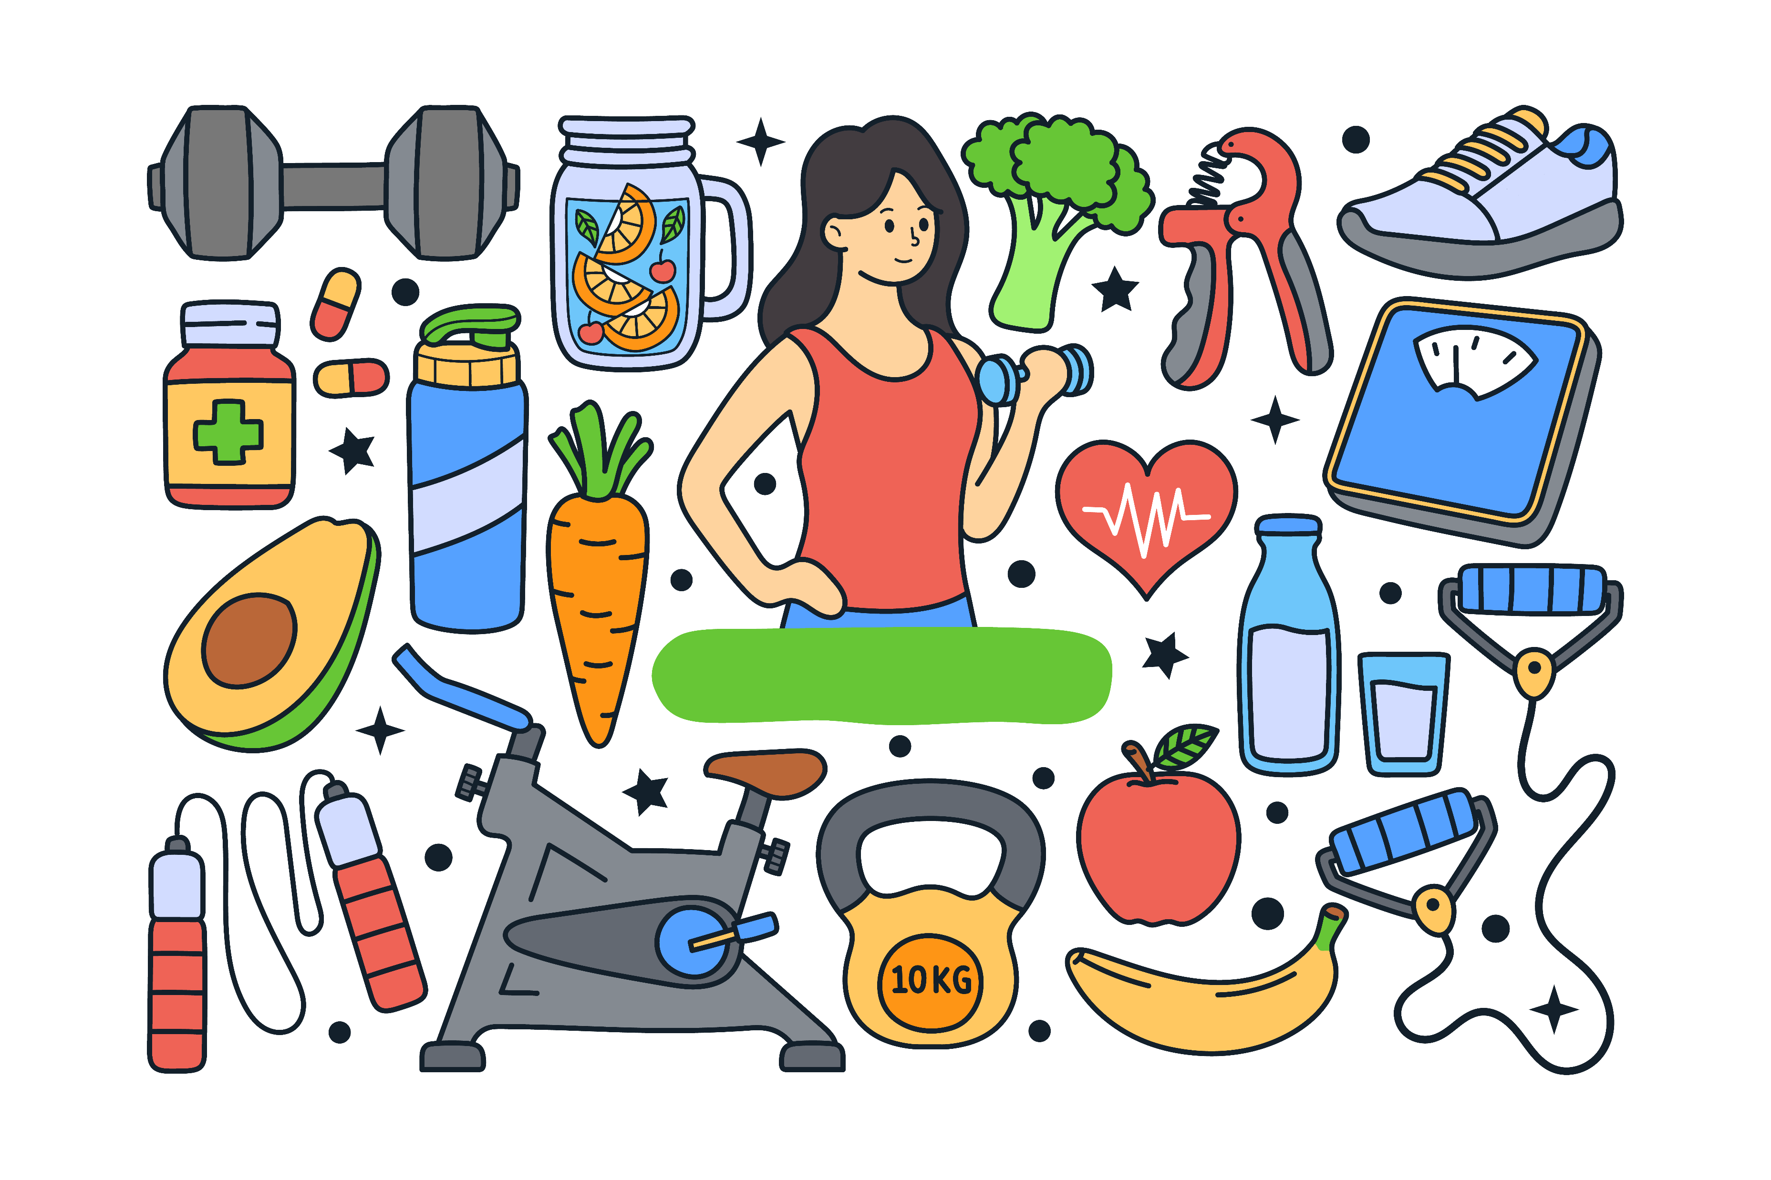
Wrap Up
Healthy weight = caring for your body
Balance food, activity, and mindful eating
Strong body = strong future
Notes:
“Let’s wrap it up. A healthy weight means caring for your body. Balance your food, activity, and mindful eating. And remember, it’s not about being perfect—it’s about making choices each day that help you feel your best. Strong body = strong future.”

