Slide 1


In Motion:
Power Up with Physical Activity
Presented by the American Heart Association & NFL PLAY 60

Slide 2
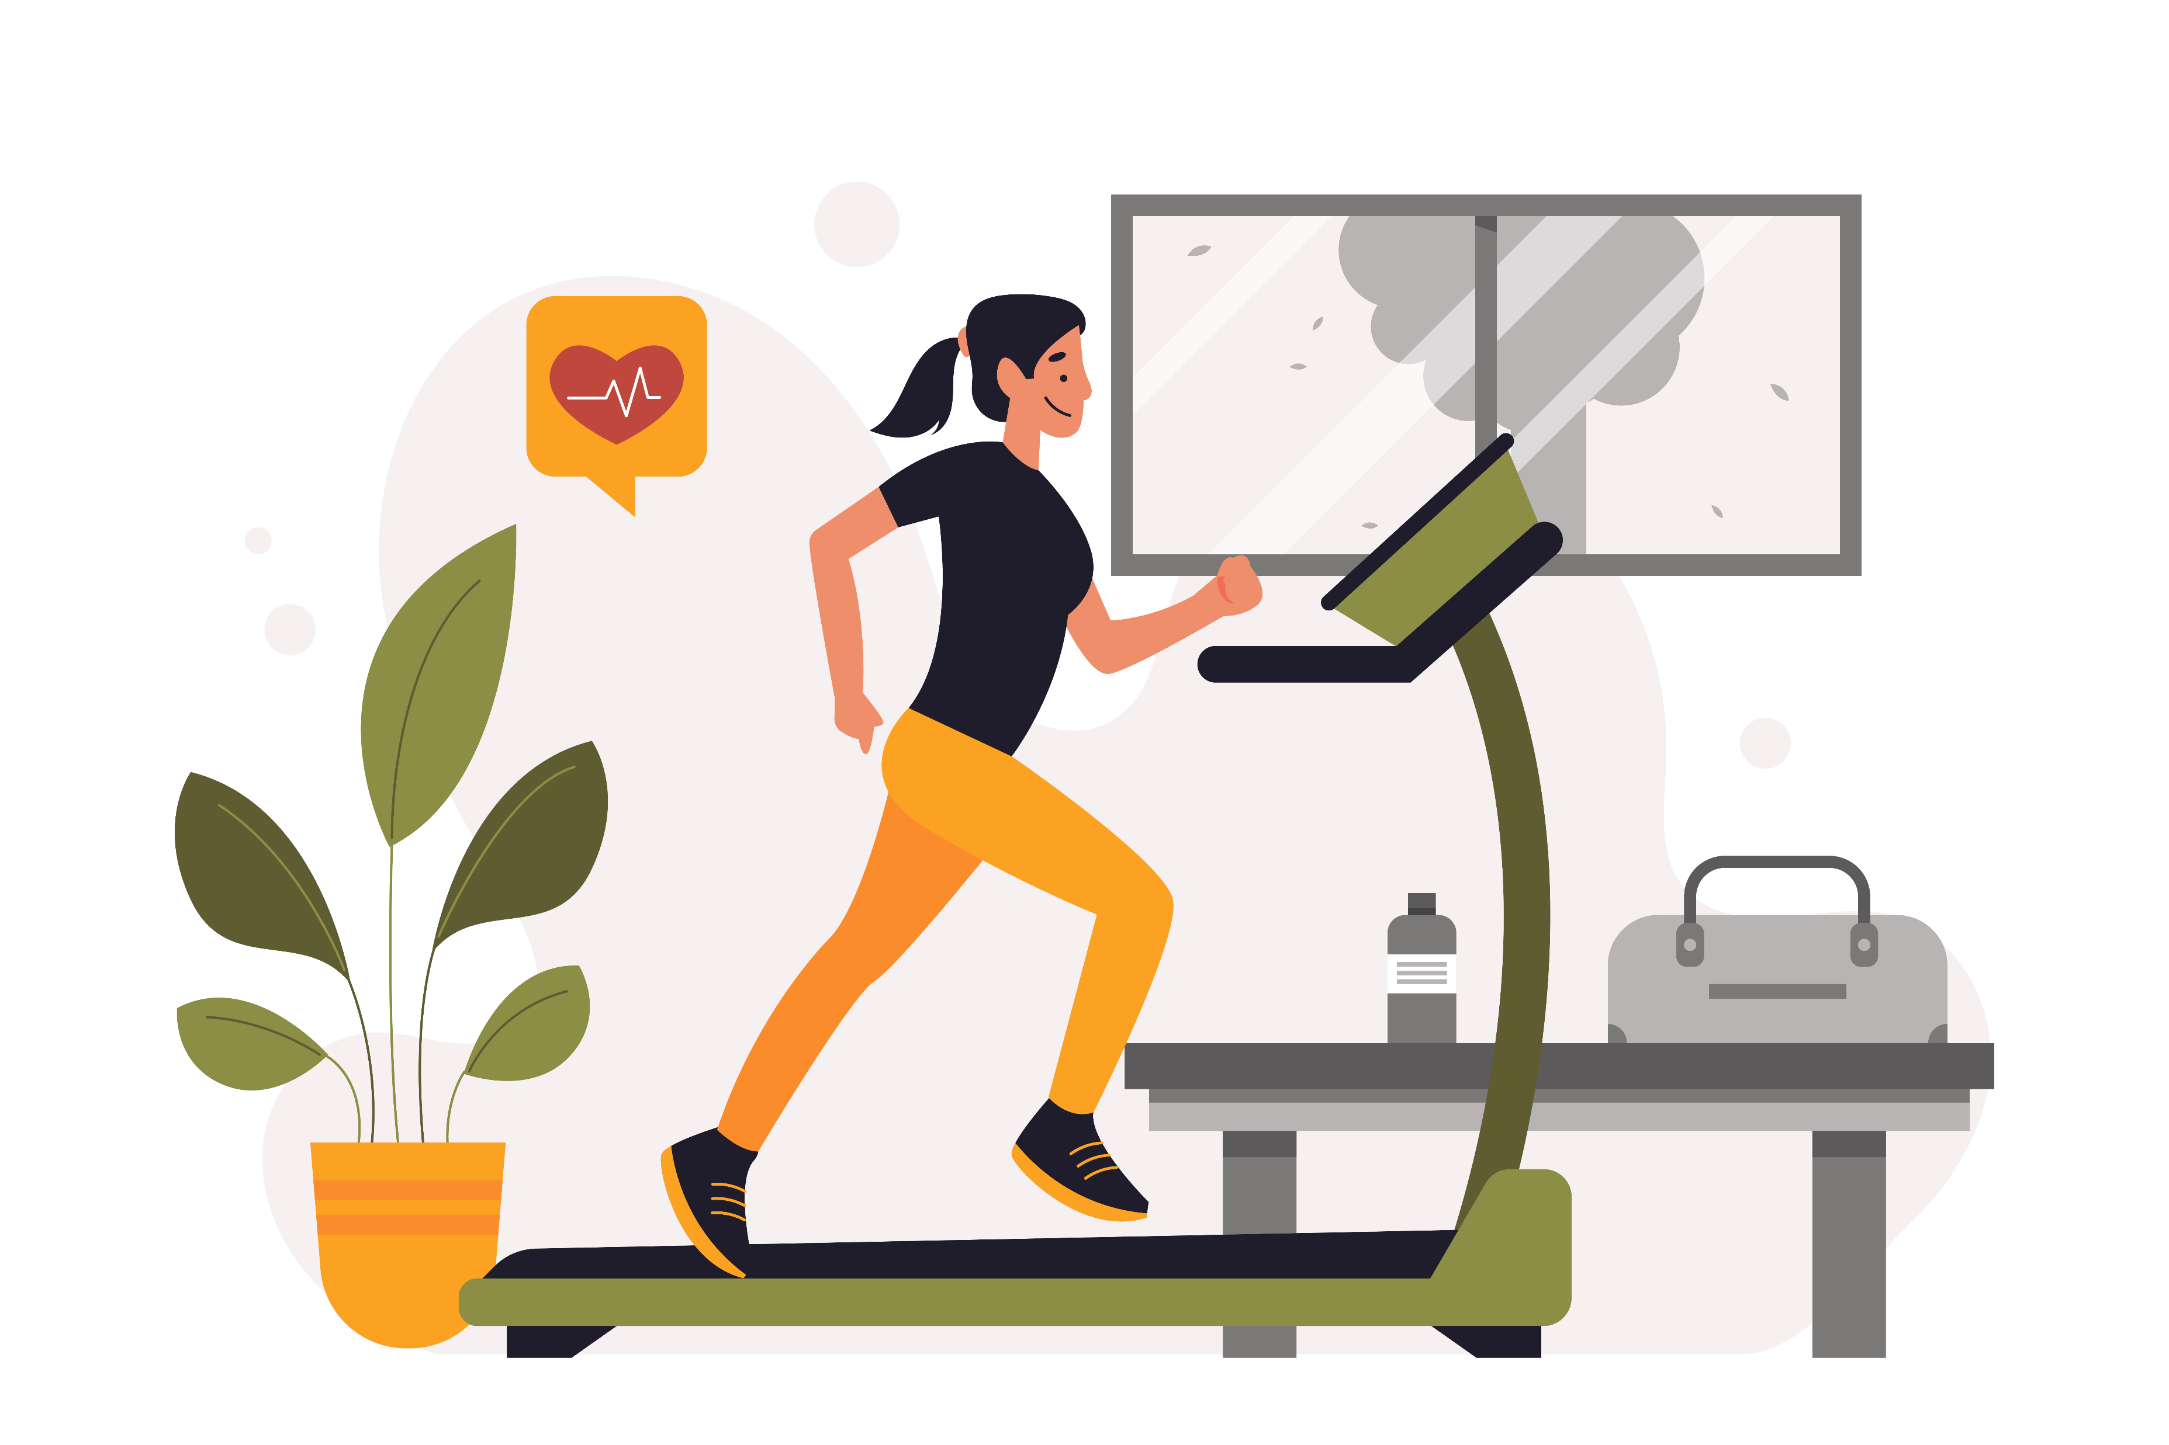
Why Move?
Exercise = energy boost
Helps us grow stronger and healthier
Makes learning and playing easier
Notes:
“Hi everyone! I’m so excited to be here with the American Heart Association and NFL PLAY 60. Today we’re going to talk about how moving our bodies gives us energy, helps us grow strong, and makes learning and playing easier. Think of exercise as your superpower—it boosts your day in so many ways!”

Slide 3
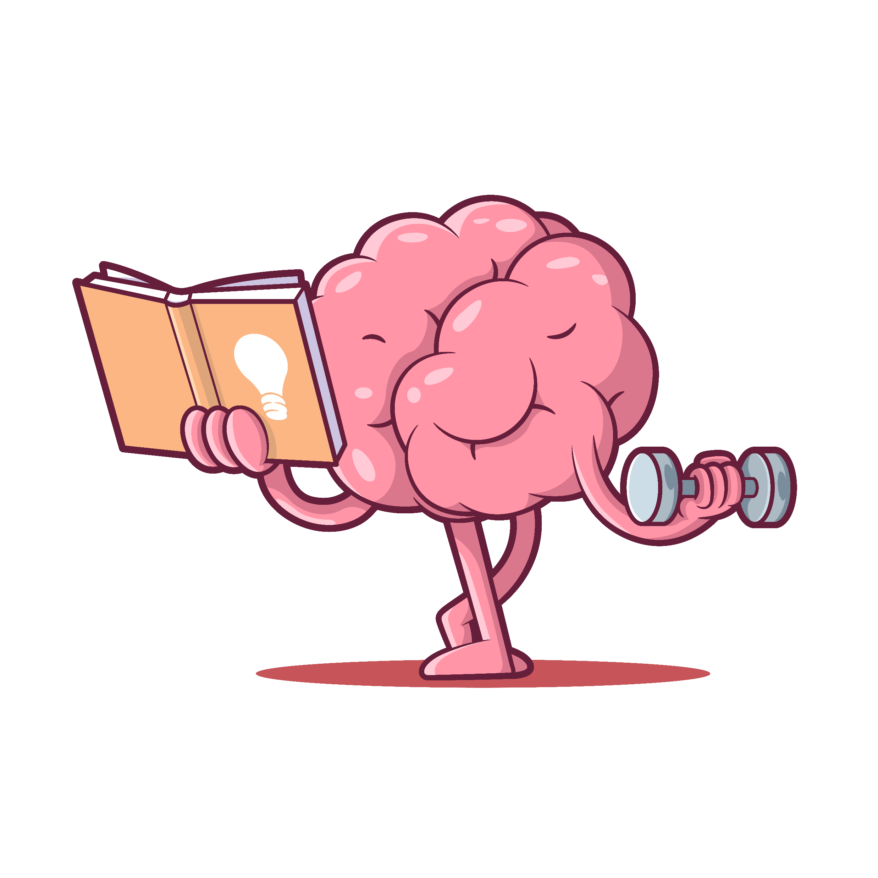
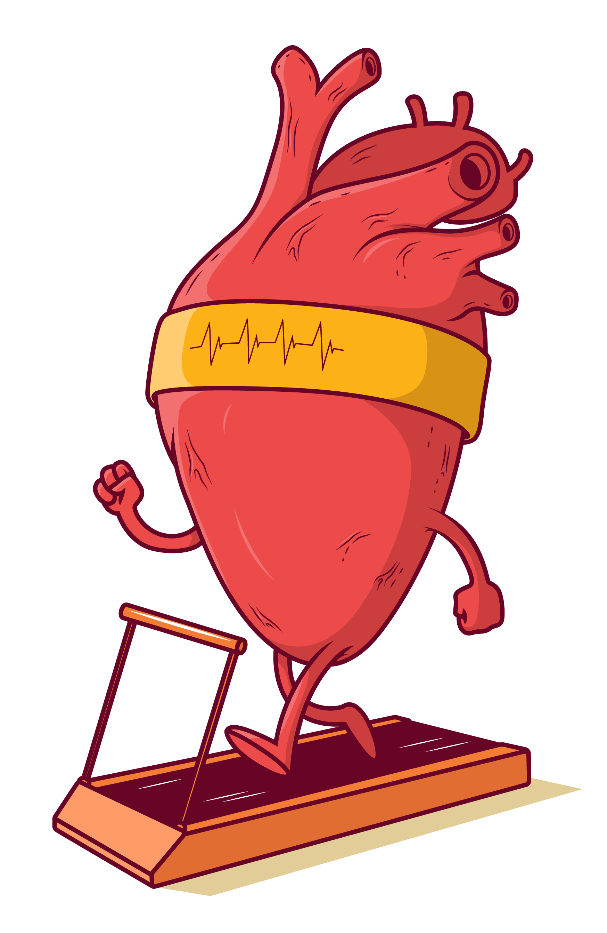
Superpowers of Exercise
Brain: feel-good hormones, focus, accomplishment
Heart: stronger, prevents future disease
Bones & Muscles: get stronger with movement
Notes:
“When you move, your body and brain get stronger. Exercise helps your brain release feel-good hormones that improve focus. It makes your heart stronger and protects you from disease later in life. And it builds strong bones and muscles. So every time you’re active, you’re powering up your brain, heart, and body.”

Slide 4
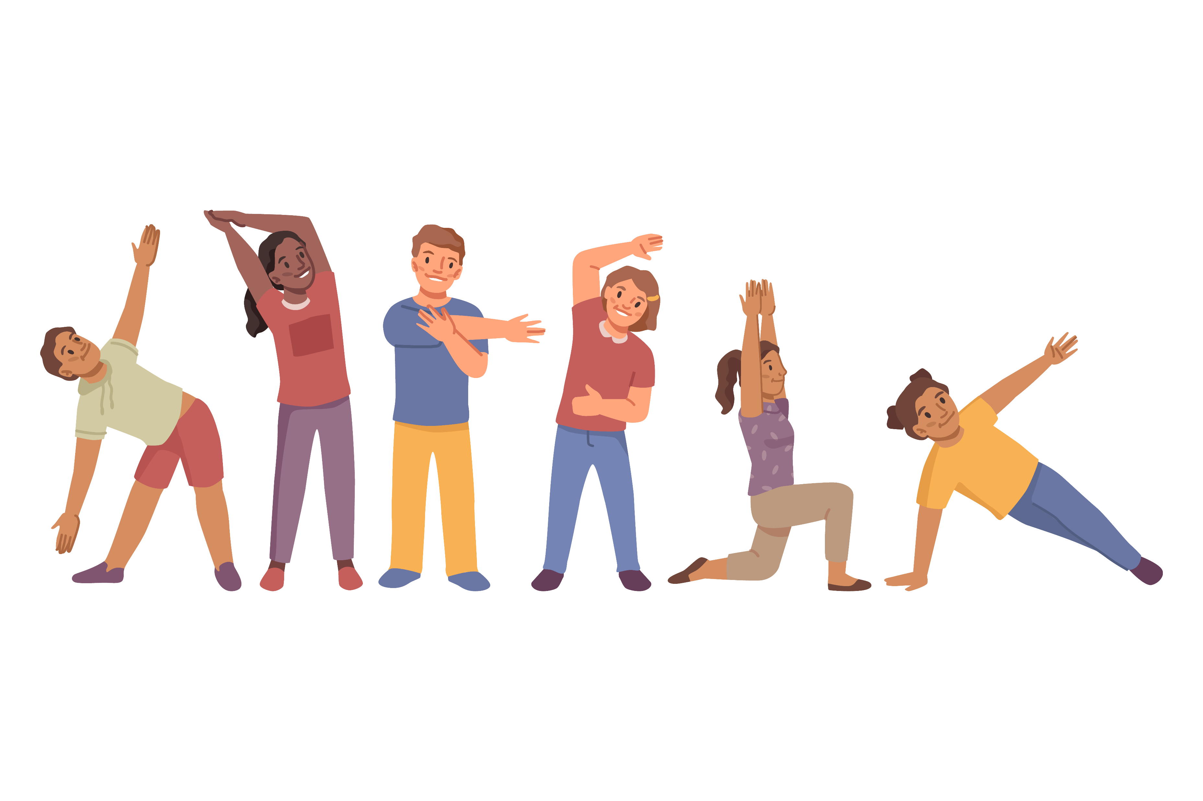
Quiz #1: What is the daily goal for kids and teens?
20 minutes
60 minutes
2 hours
Notes:
“Quick question for you: What is the daily goal for kids and teens?
a) 30 minutes
b) 60 minutes
c) 90 minutes
[Pause and let students answer.]
That’s right—it’s b) 60 minutes every day!”

Slide 5
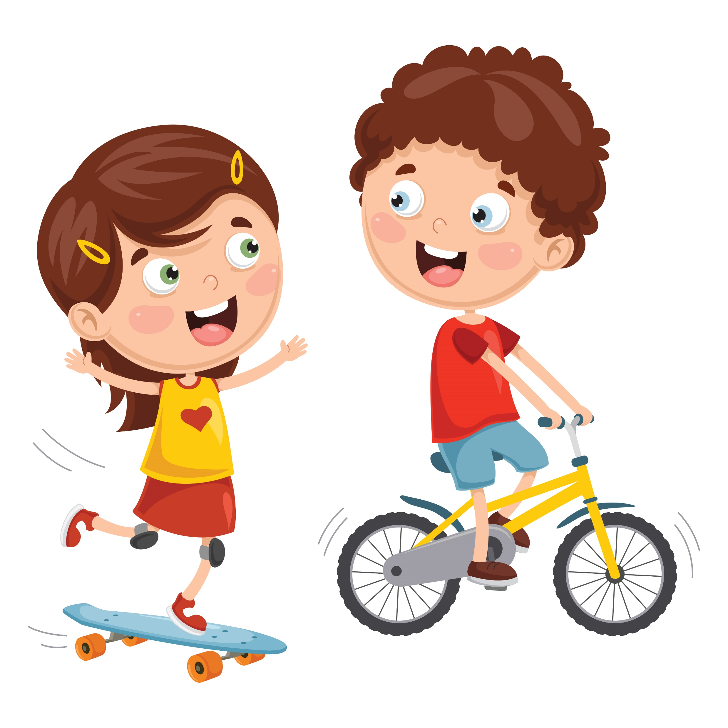

PLAY 60 Challenge
NFL + AHA created NFL PLAY 60
Goal: 60 minutes of play every day
Includes sports, dance, biking, walking, games
The American Heart Association and
the National Football League are working together to get youth physically active.
Notes:
“The American Heart Association and the NFL teamed up to create the PLAY 60 Challenge. The goal is simple—get 60 minutes of play every day. That could be sports, dance, biking, walking, or just playing games. As long as you’re moving, it counts!”

Slide 6
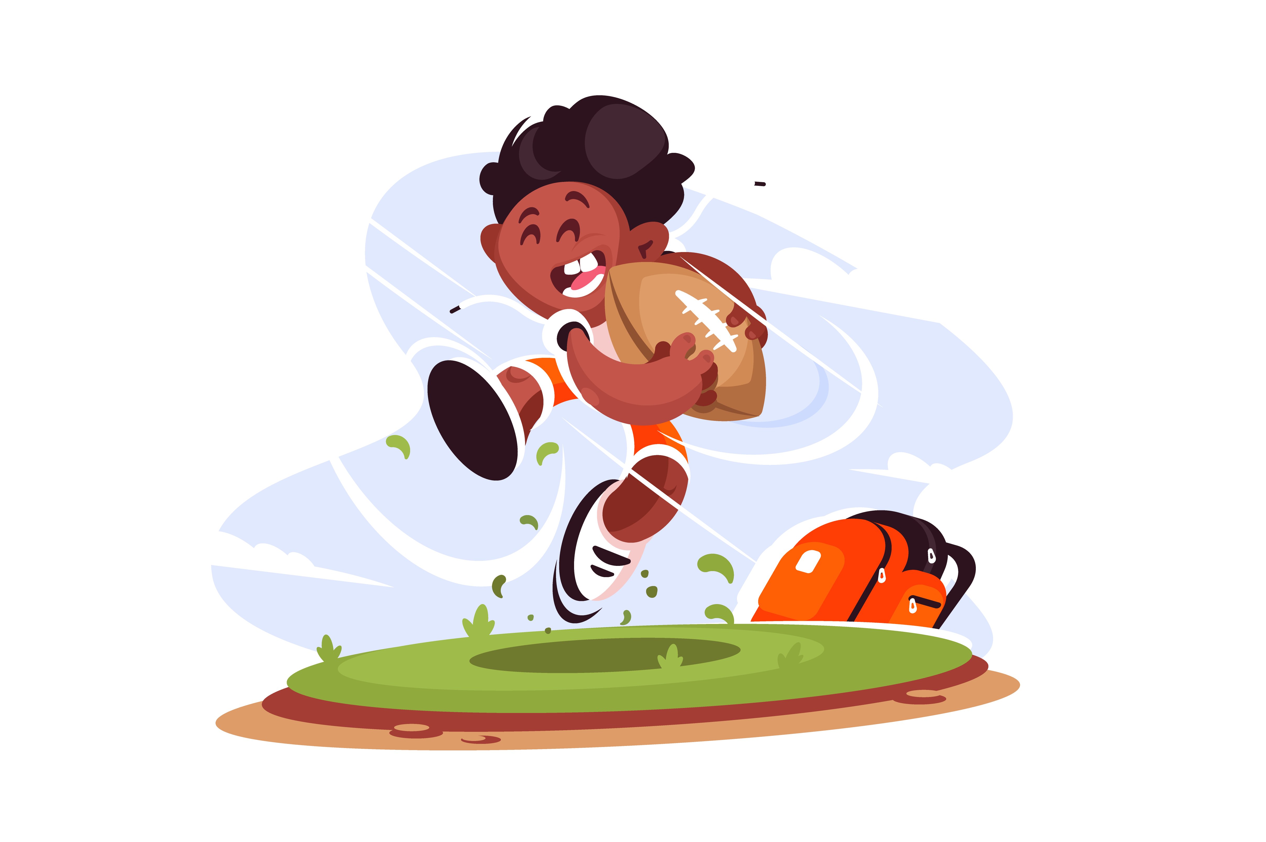
Quiz #2: PLAY 60 means you have to play football for 60 minutes every day.
True
False
Notes:
“True or False: PLAY 60 means you have to play football for 60 minutes every day.
[Pause for answers.]
The answer is False! PLAY 60 is about any kind of fun movement—not just football.”

Slide 7
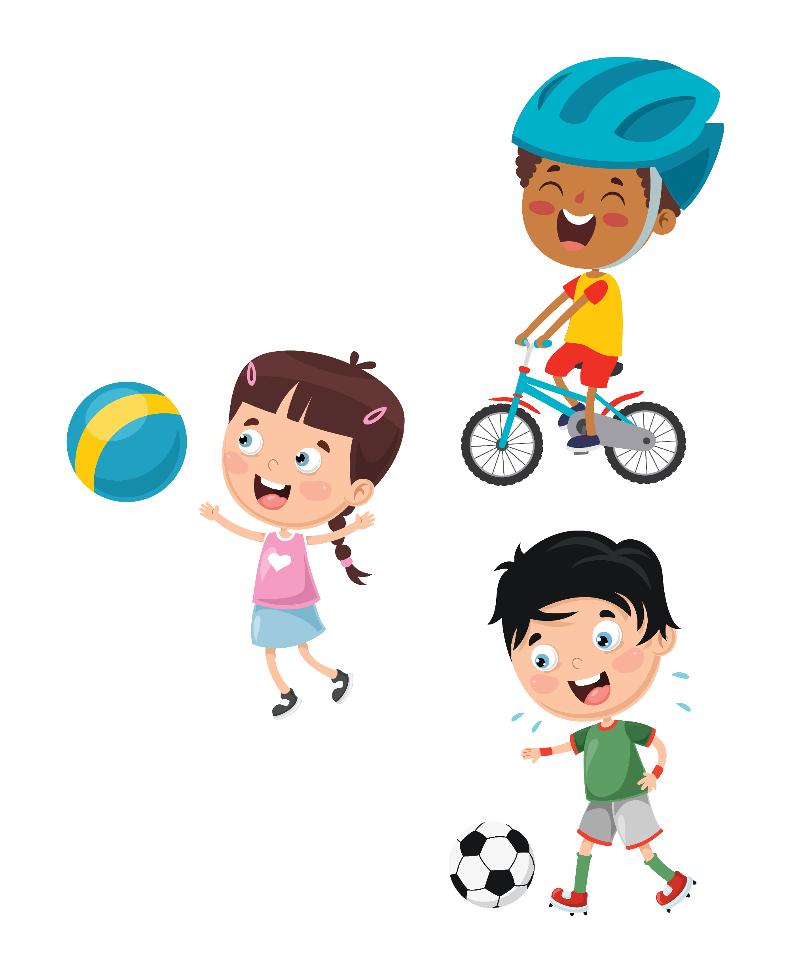
Fun Ways to Move
Dance to your favorite song
Ride your bike or scooter
Play soccer, basketball, or flag football
Walk the dog or play tag
Notes:
“Let’s brainstorm! You could dance to your favorite song, ride your bike or scooter, play soccer, basketball, or flag football, or even take the dog for a walk or play tag. The important thing is to find something you enjoy.”

Slide 8
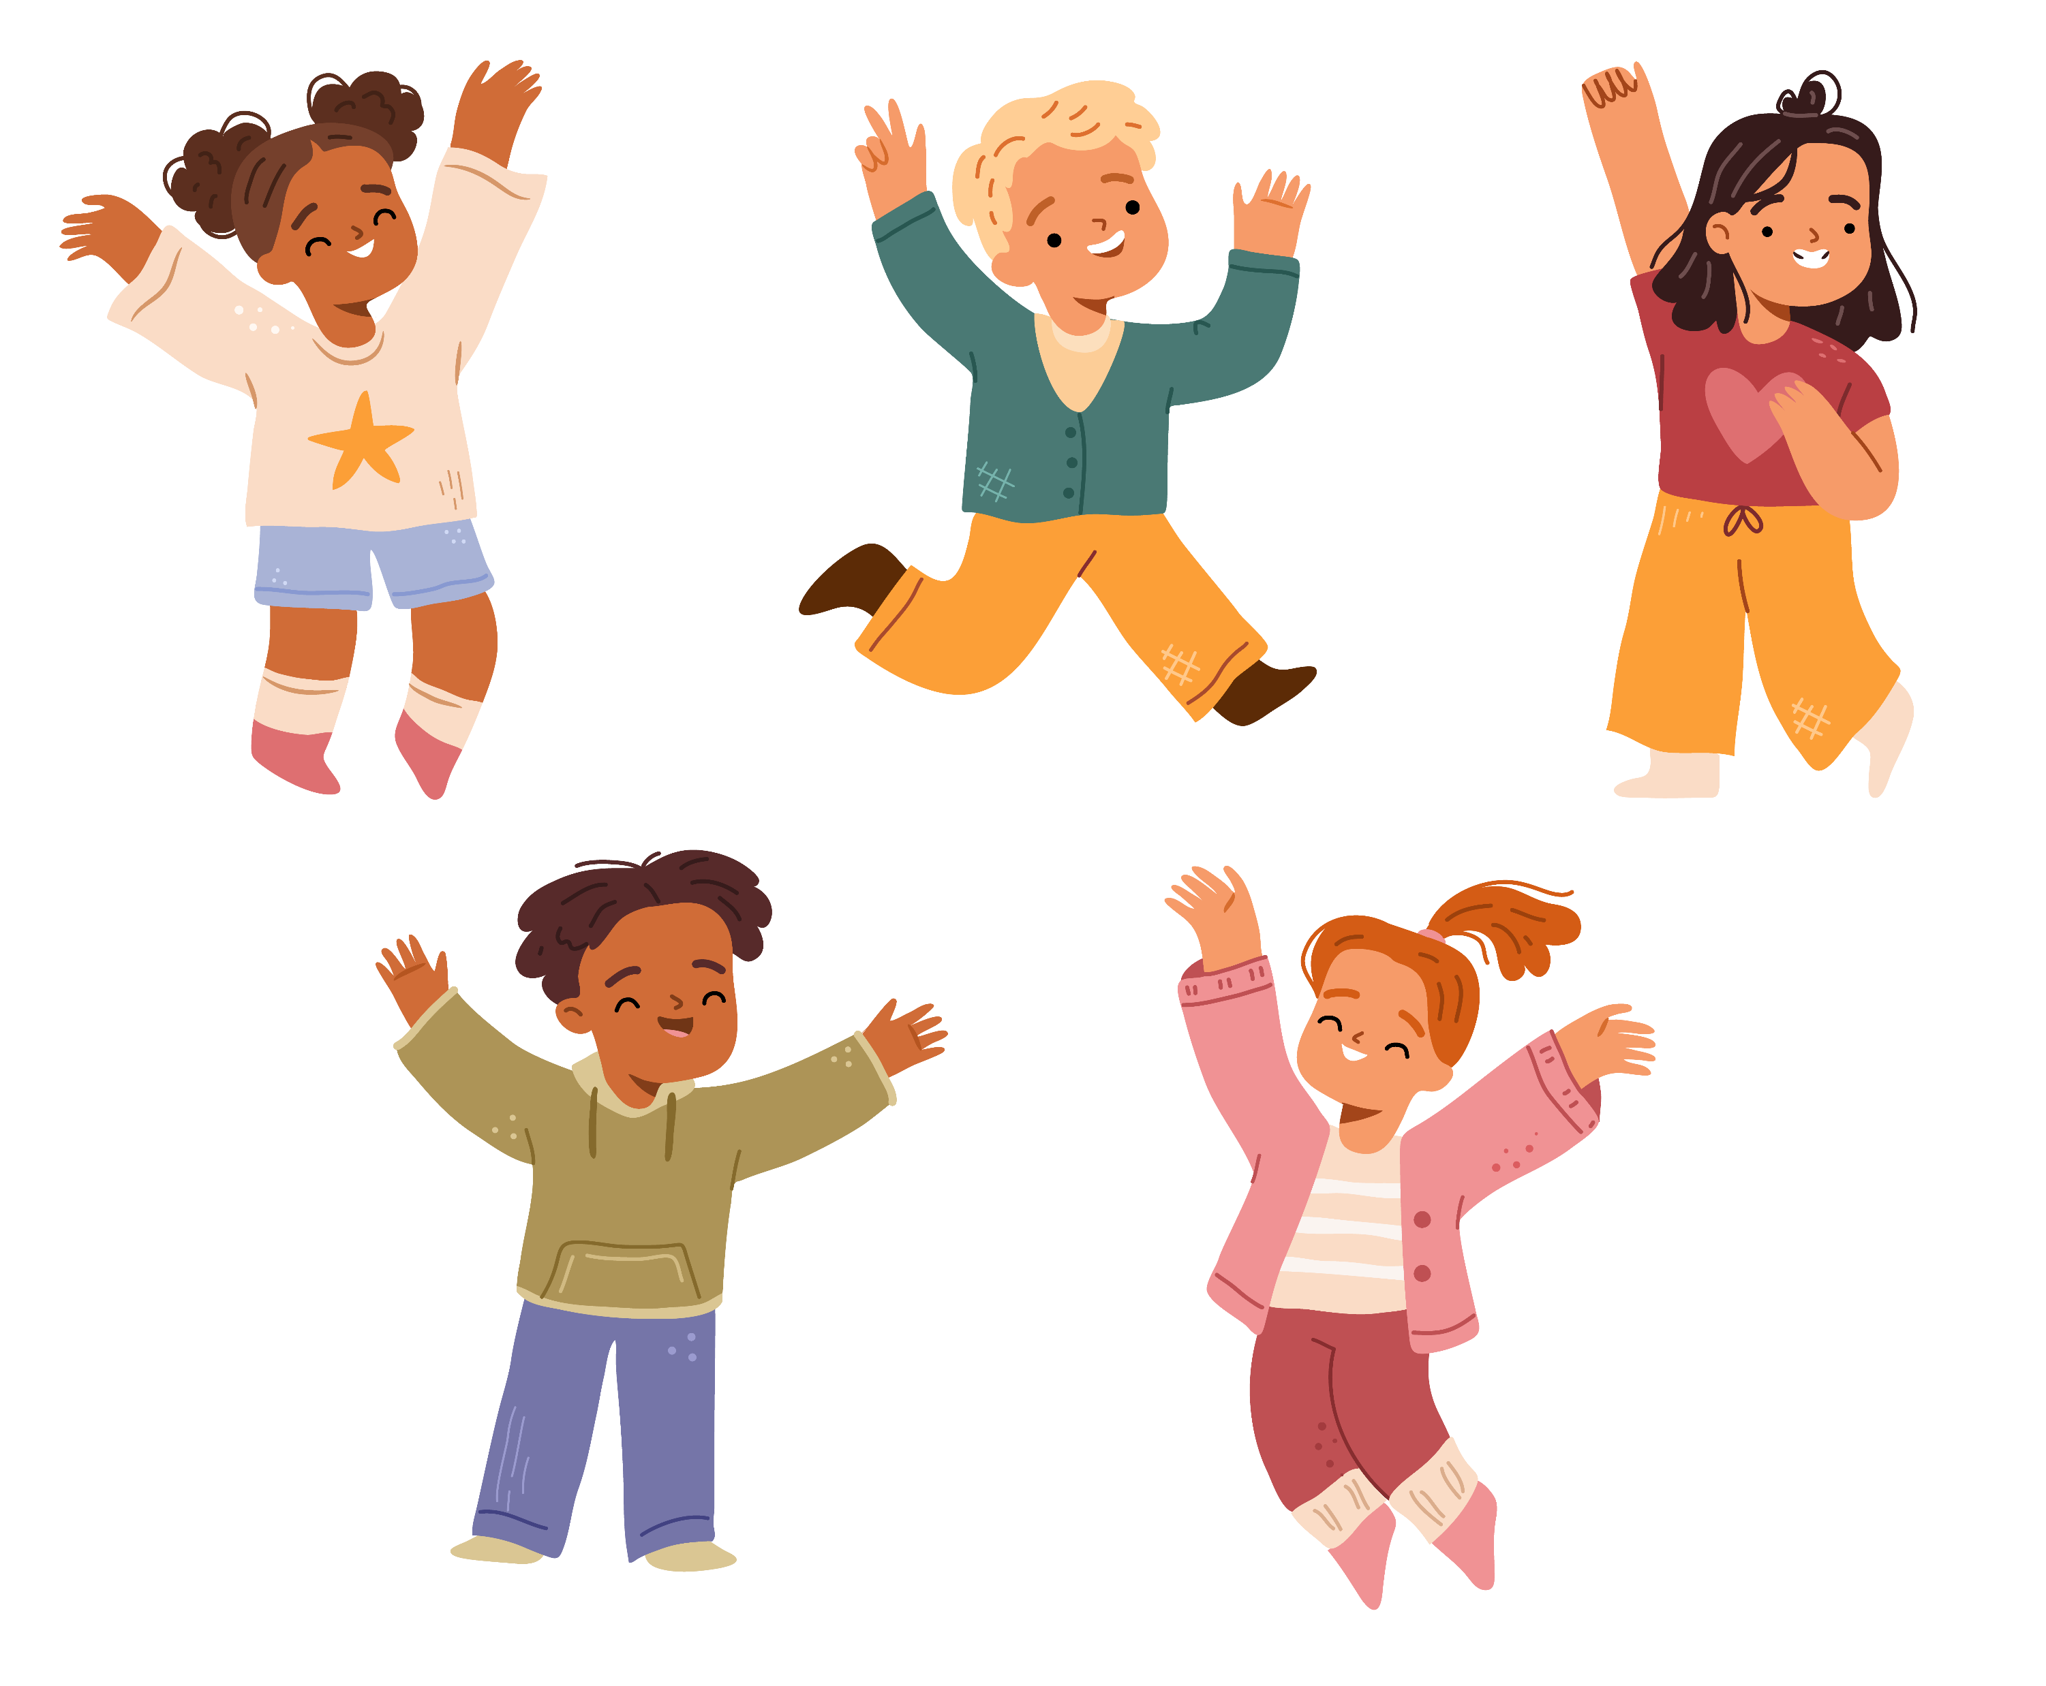
Quiz #3: Which activity counts toward PLAY 60?
Video games on the couch
Dancing with friends
Scrolling on your phone
Notes:
“Which of these activities counts toward PLAY 60?
a) Sitting and watching TV
b) Dancing with friends
[Pause for answers.]
Yes—b) Dancing with friends! If it gets you moving, it counts.”

Slide 9
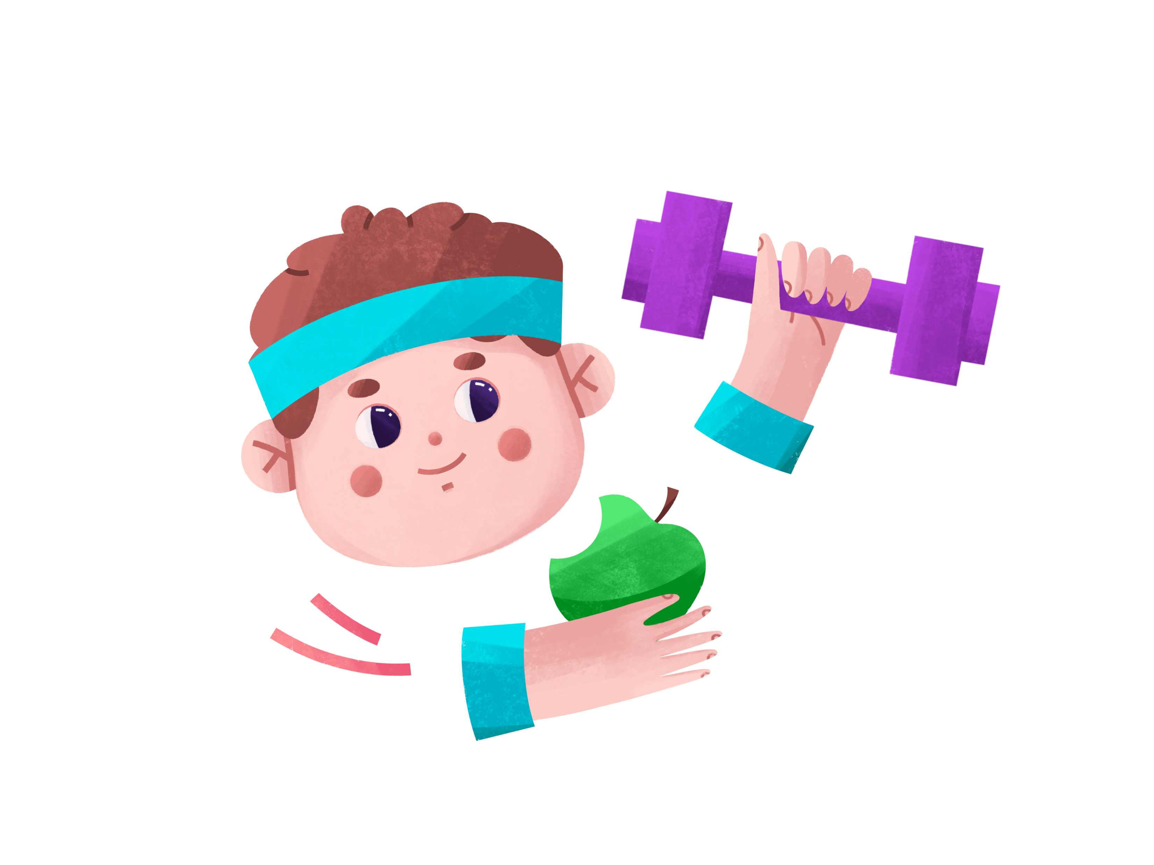
Healthy Habits for Life
Pair movement with healthy eating
Stay active with friends or family
Make it part of your daily routine
Notes:
“Exercise works best when you combine it with other healthy habits—like eating fruits and veggies, staying active with friends or family, and making movement part of your daily routine.”

Slide 10
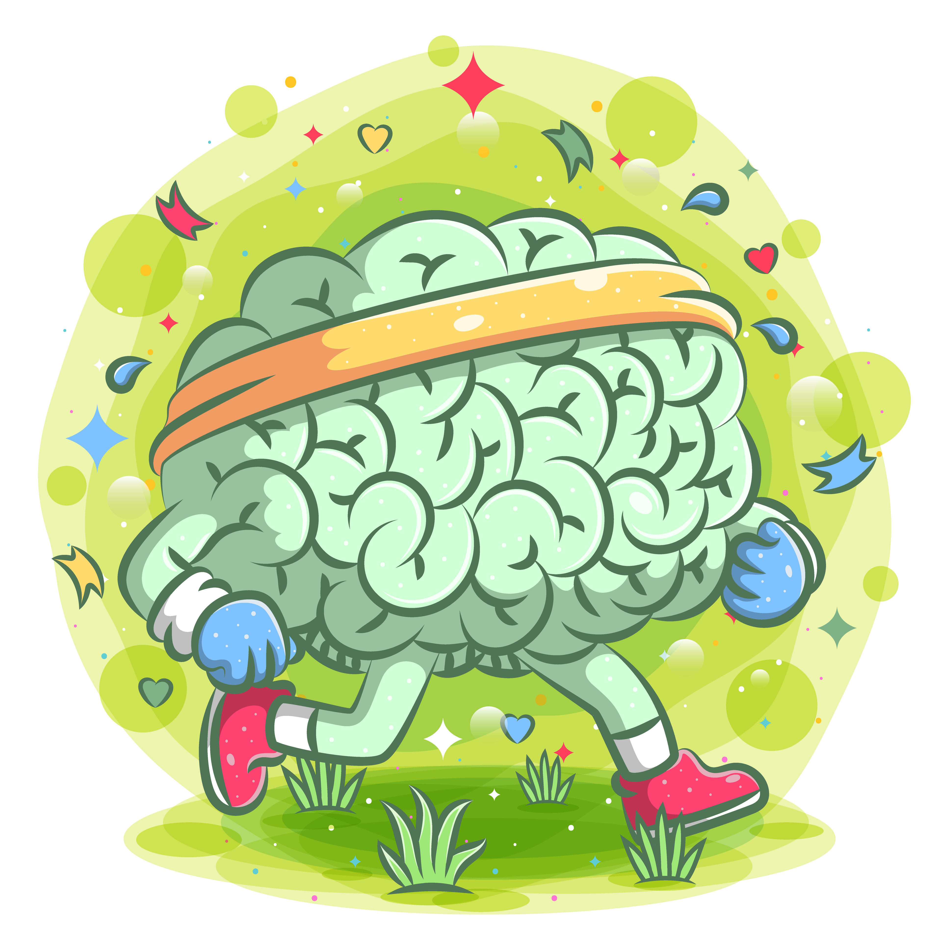
Quiz #4: Fill in the blank: Exercise helps your ______ feel good.
Brain
Shoes
Backpack
Notes:
“Fill in the blank: Exercise helps your ______ feel good.
a) Brain
b) Hair
c) Shoes
[Pause for answers.]
The answer is a) Brain! Movement powers your brain, heart, and body.”

Slide 11

Why It Matters for the Future
Active kids = healthier adults
Reduces risk of obesity, diabetes, high blood pressure
Builds confidence and teamwork
Notes:
“Kids who stay active grow into healthier adults. Being active reduces your risk of obesity, diabetes, and high blood pressure, and it also builds confidence and teamwork.”

Slide 12
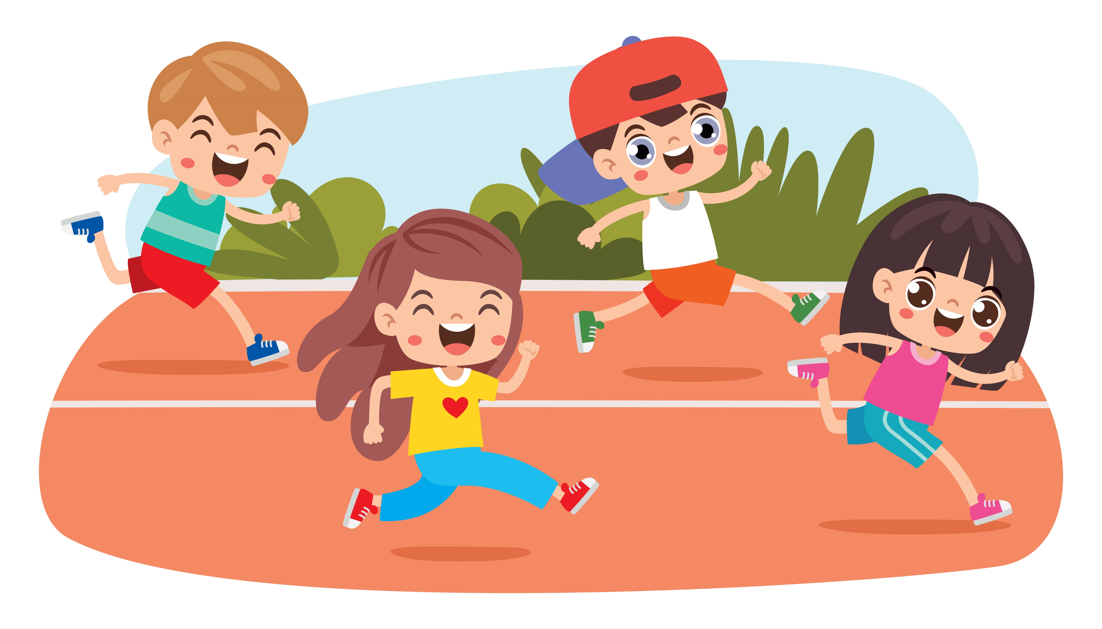
Wrap Up
Move at least 60 minutes daily
Exercise = superpower for brain, heart, and body
Join the AHA & NFL PLAY 60 team to build a healthier future
Notes:
“So let’s review:
Move at least 60 minutes every day.
Remember—exercise is your superpower for your brain, heart, and body.
And join the AHA and NFL PLAY 60 team to build a healthier future together.”

