Slide 1


Healthy Eating
with the American Heart Association
Fuel your body, fuel your life!

Slide 2
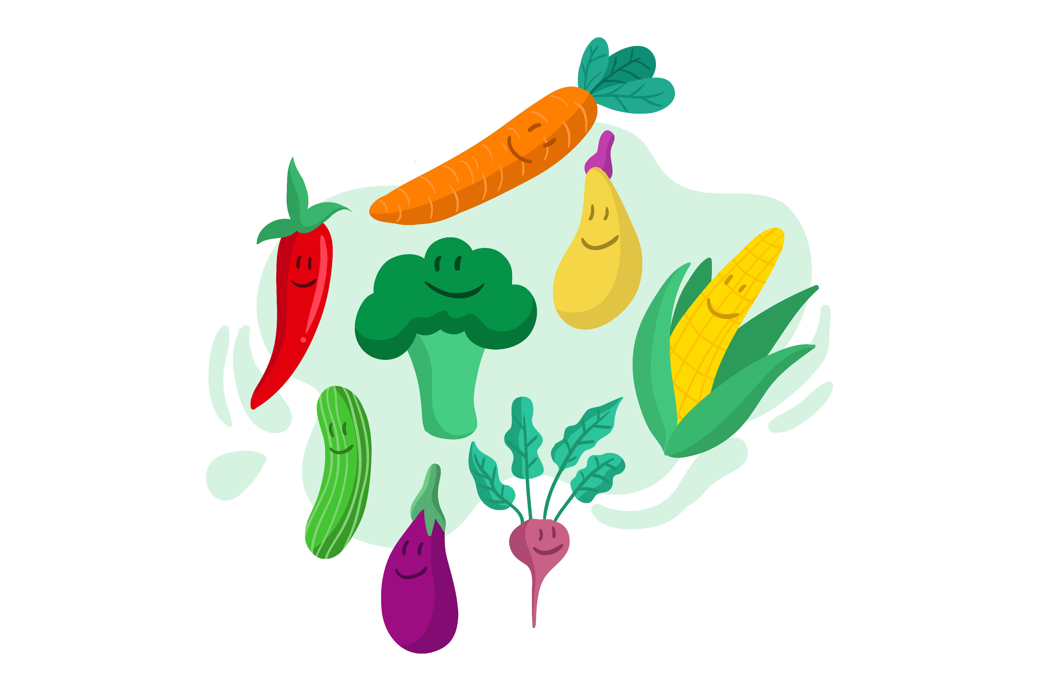
Why Healthy Eating Matters
Food = fuel for your body and brain
Eating well helps us feel good, do better in school, and play harder in sports.
Balance is key: It’s not about being perfect.

Slide 3
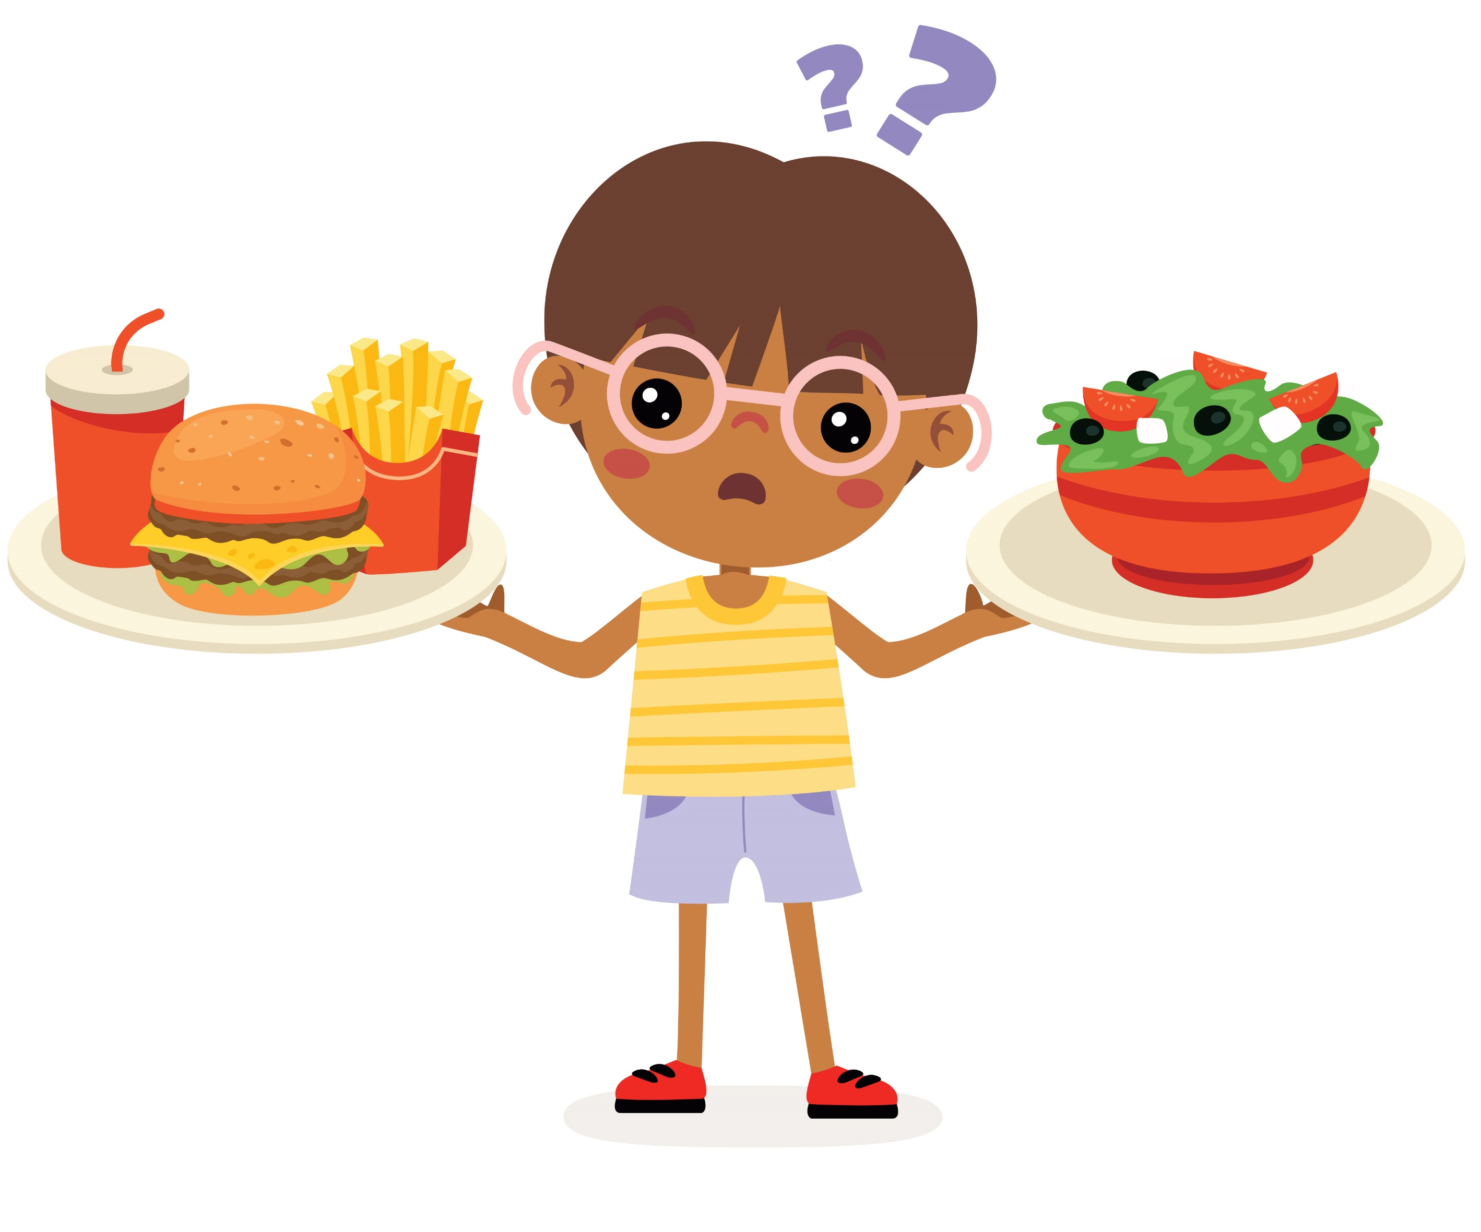
Quiz #1: Your body is like a car. What does it need to run well?
Candy and soda
The right fuel (healthy foods)
Nothing at all
Notes:
(Correct: b – Healthy foods are your body’s fuel!)

Slide 4
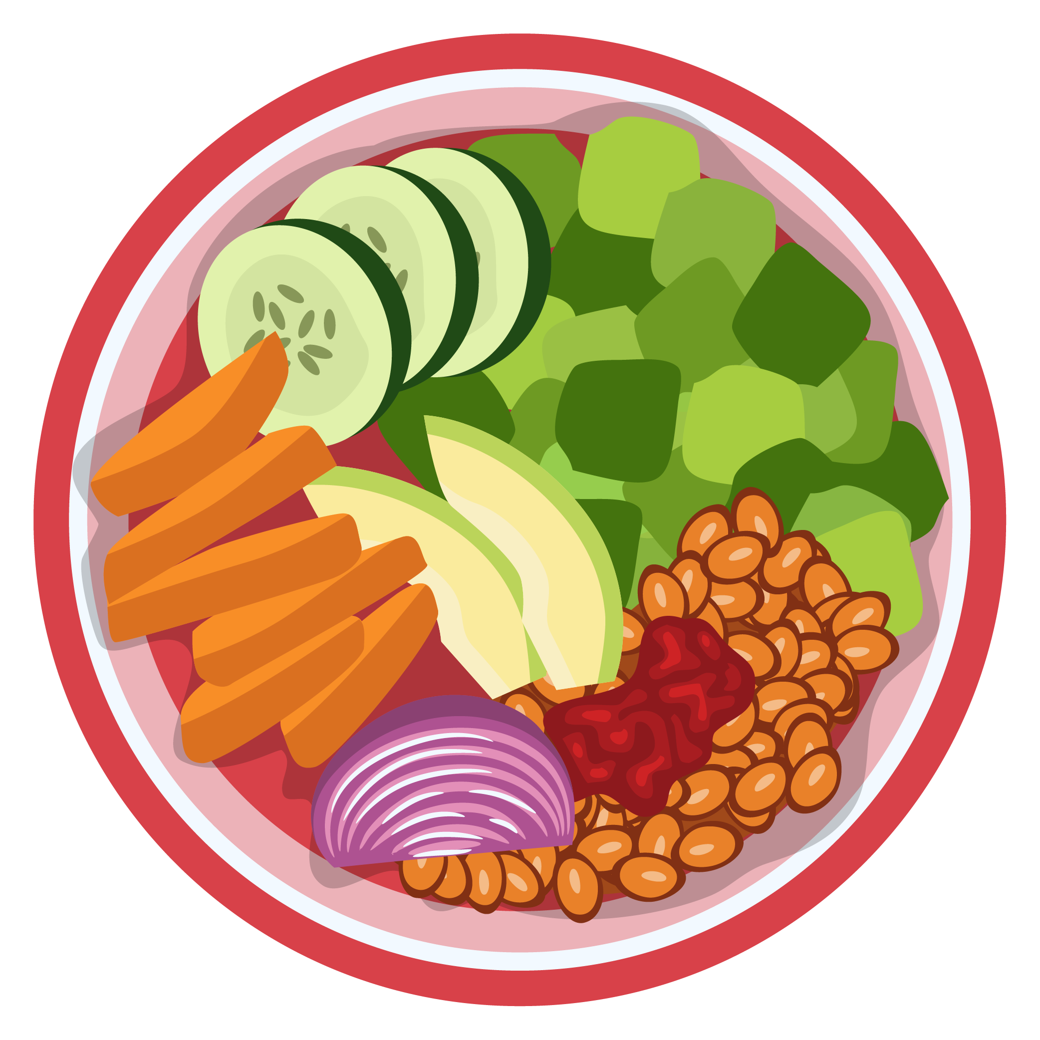
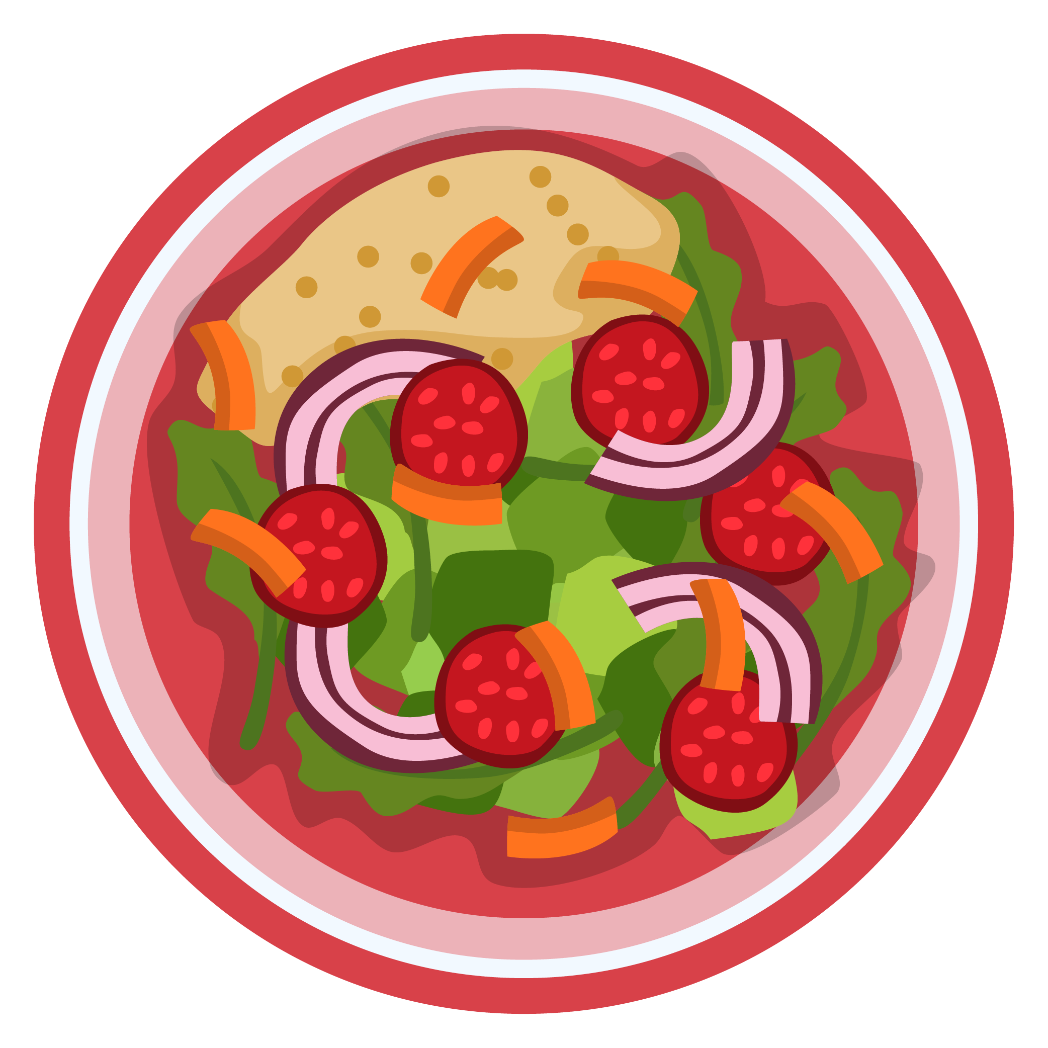
Build a
Healthy Plate
Enjoy: fruits, veggies, whole grains, beans, nuts, lean proteins, seafood
Limit: sugary drinks, salty snacks, fried and processed foods.
Avoid: trans fats.

Slide 5
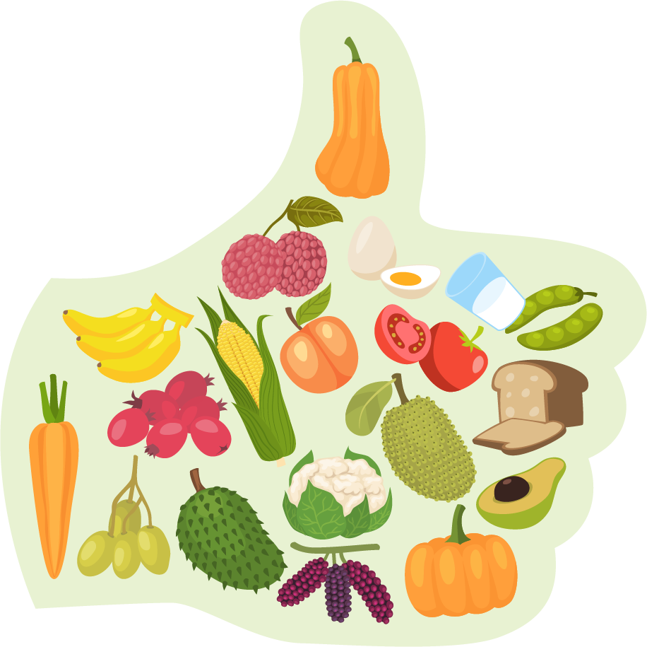
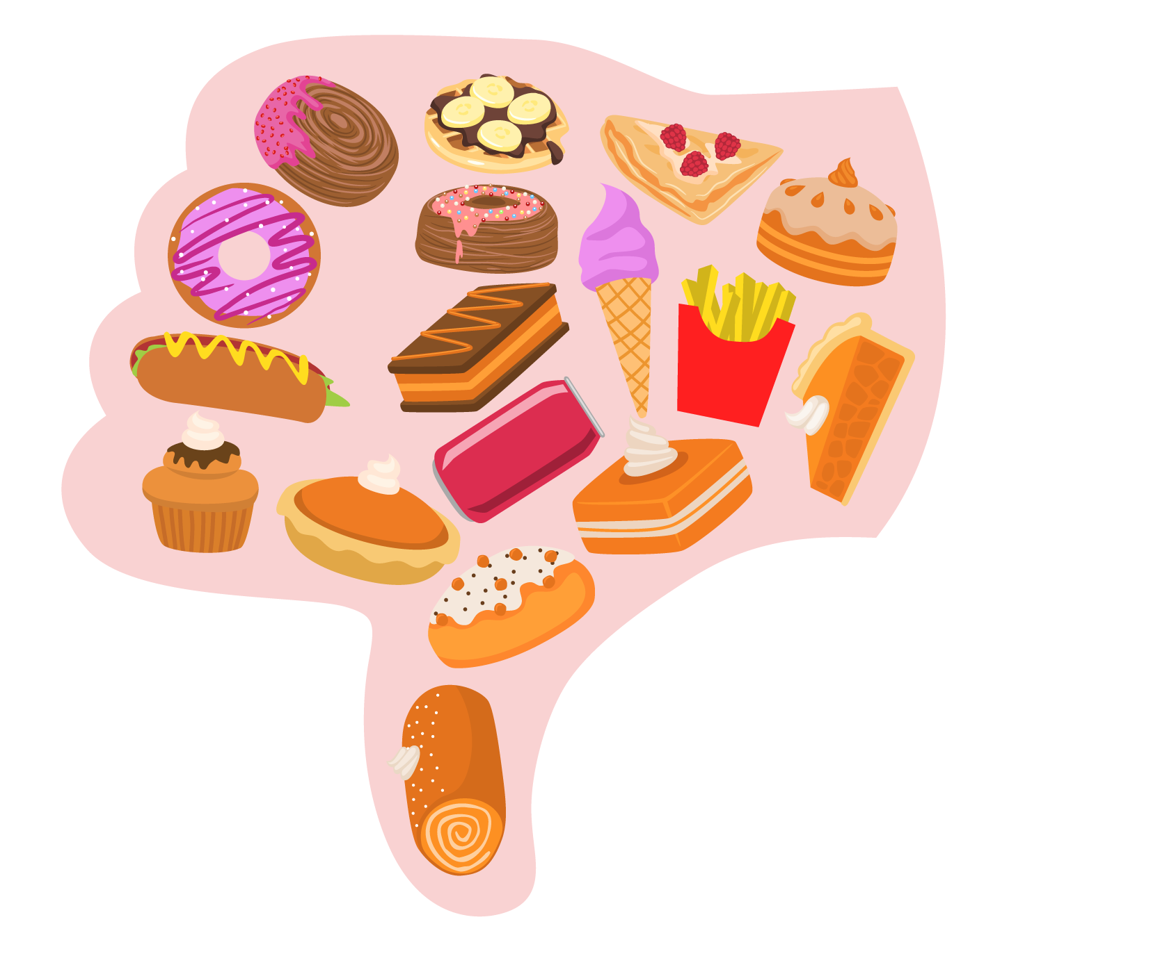
Quiz #2: Which of these is the BEST snack choice?
Potato chips and soda
Fruit and water
Candy and juice

Slide 6

The Sugar Story
Sugar = quick energy but too much can harm your body.
Sugary drinks can lead to diabetes.
Better choices: water, milk, fruit.

Slide 7

Quiz #3: Water is the ultimate super fuel for your body.
True
False
Notes:
(Answer: True!)

Slide 8
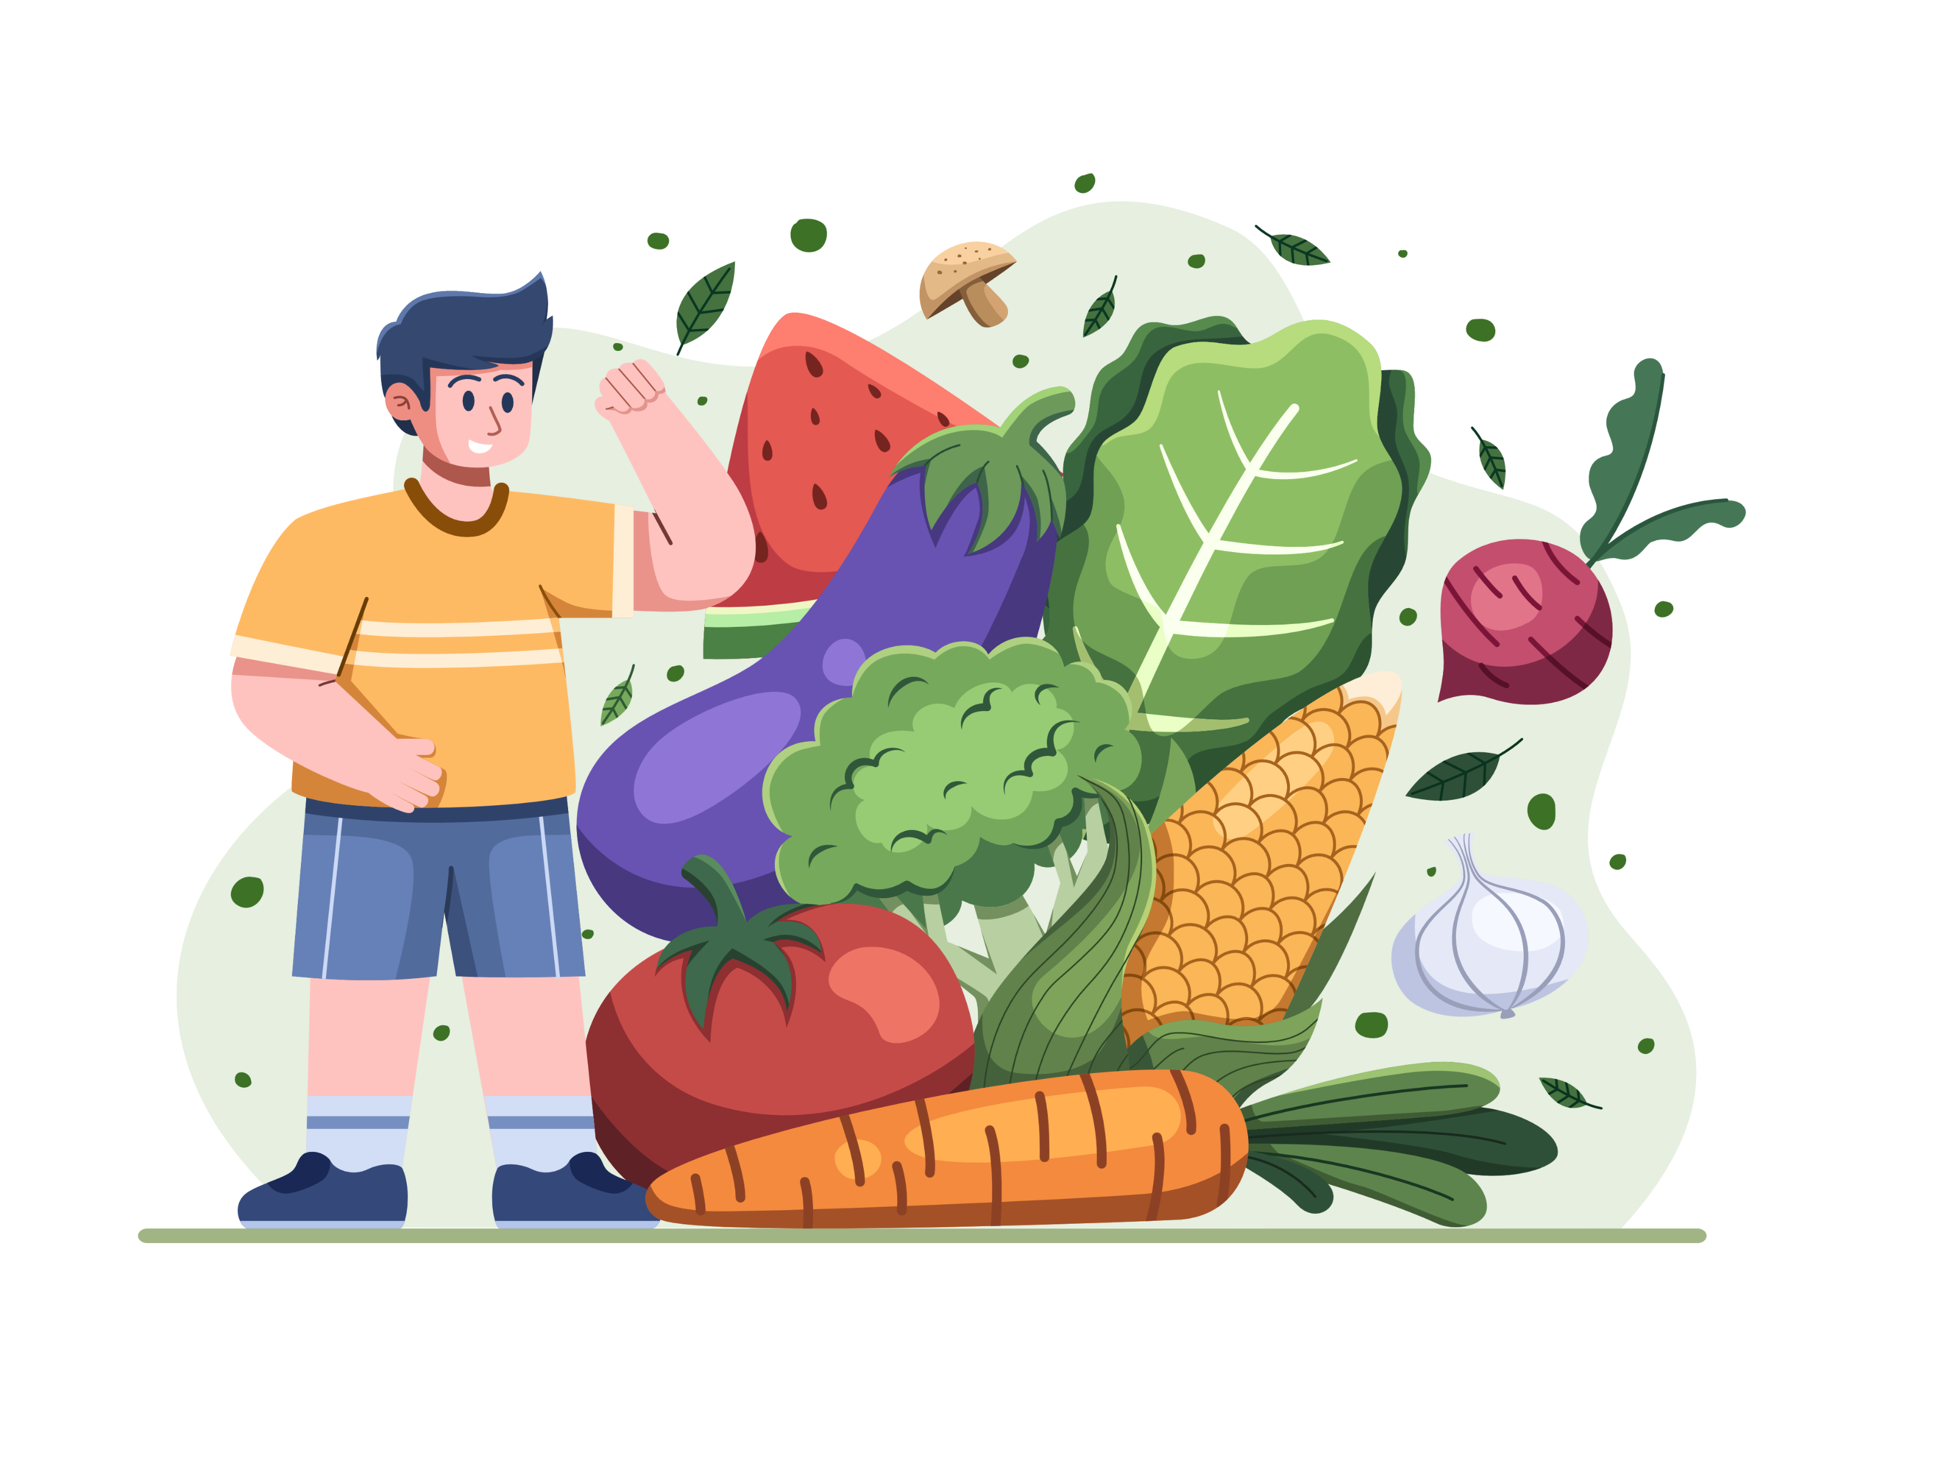
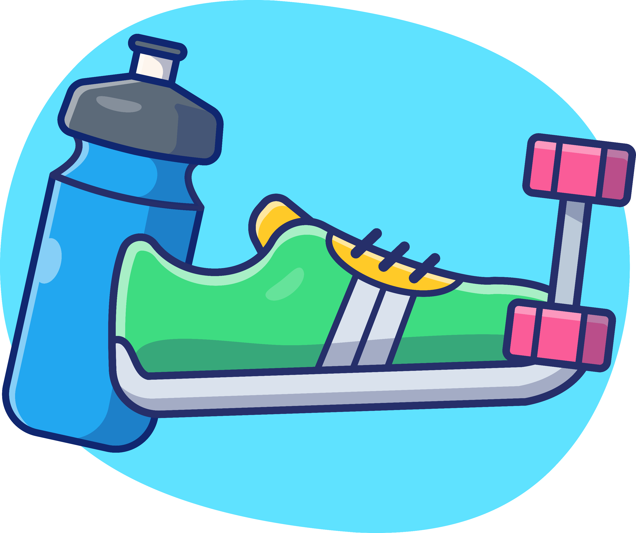
Balanced Bodies
Eating well + being active keeps your body balanced.
Healthy weight is about health, not looks.
Eat when hungry, stop when full.

Slide 9
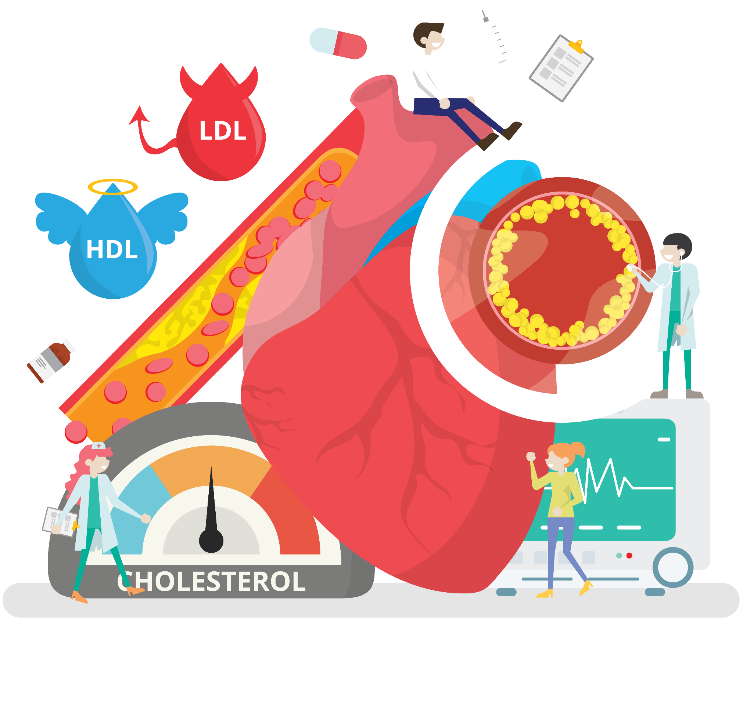
Building Blocks of the Body
GOOD
cholesterol (HDL):
cleans up.
BAD
cholesterol (LDL):
clogs arteries.

Slide 10
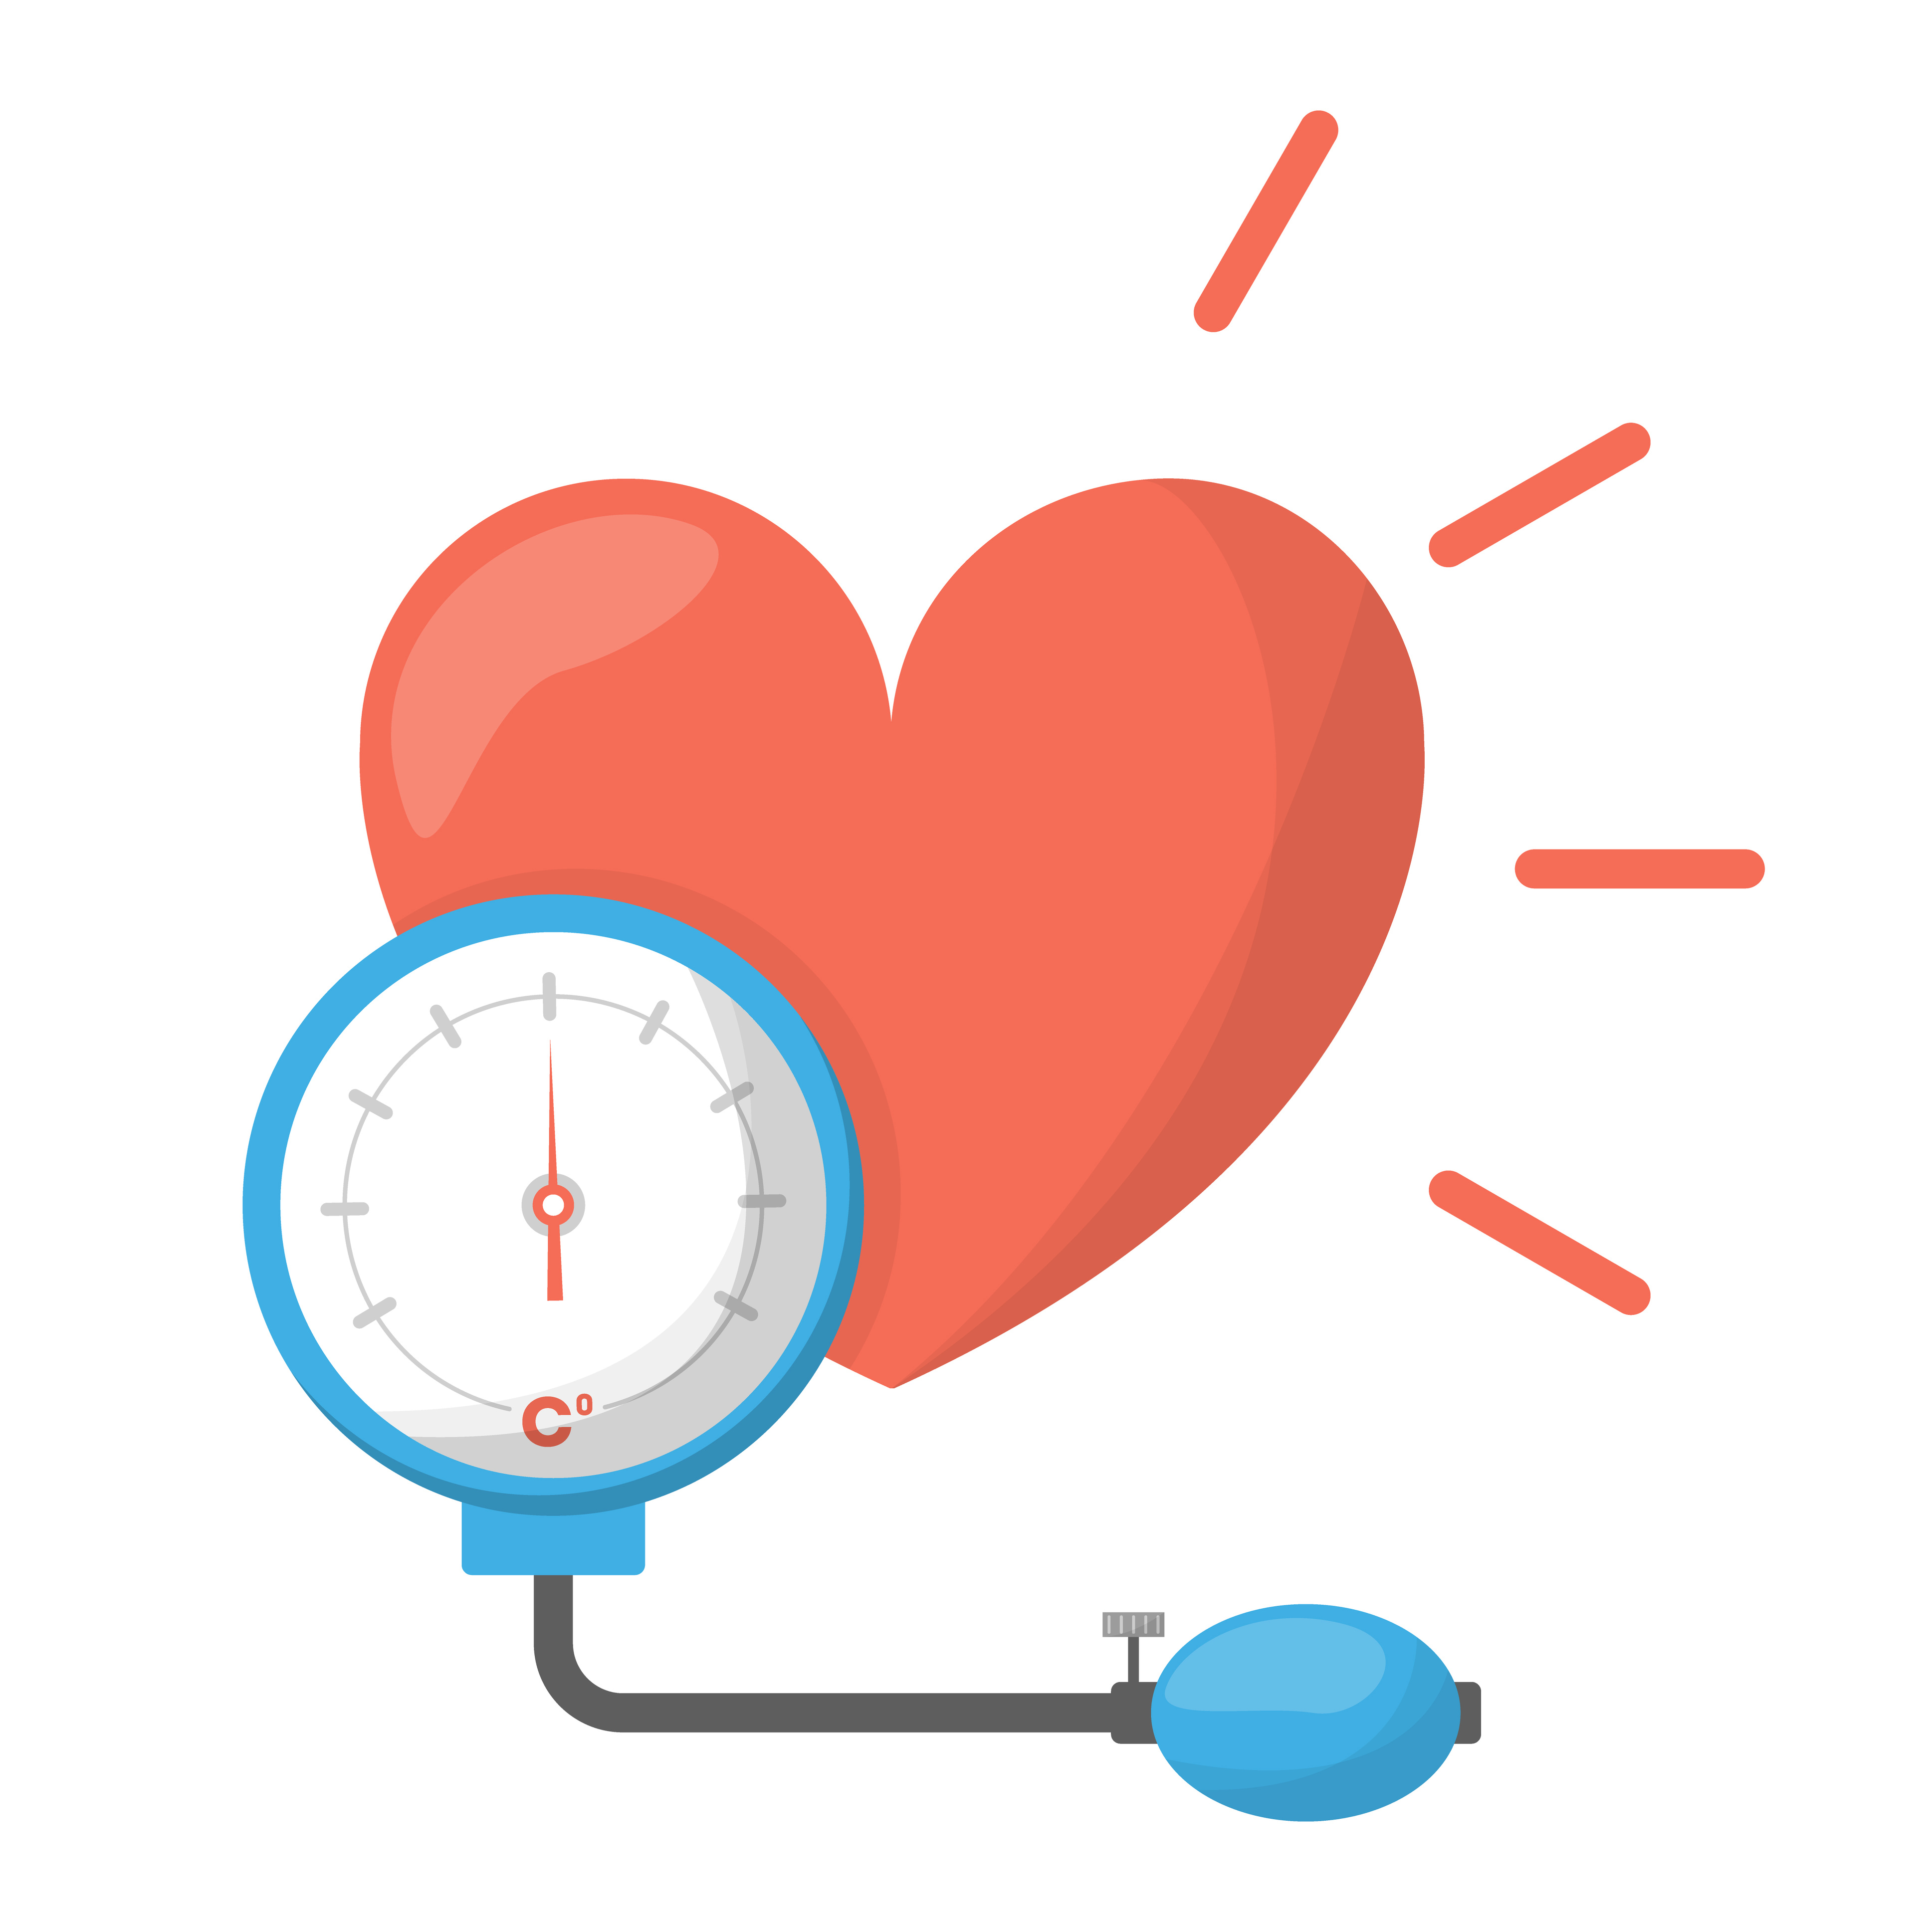
Don’t Be Pressured
Too much salty/fatty food raises blood pressure.
High BP makes the heart work harder.

Slide 11
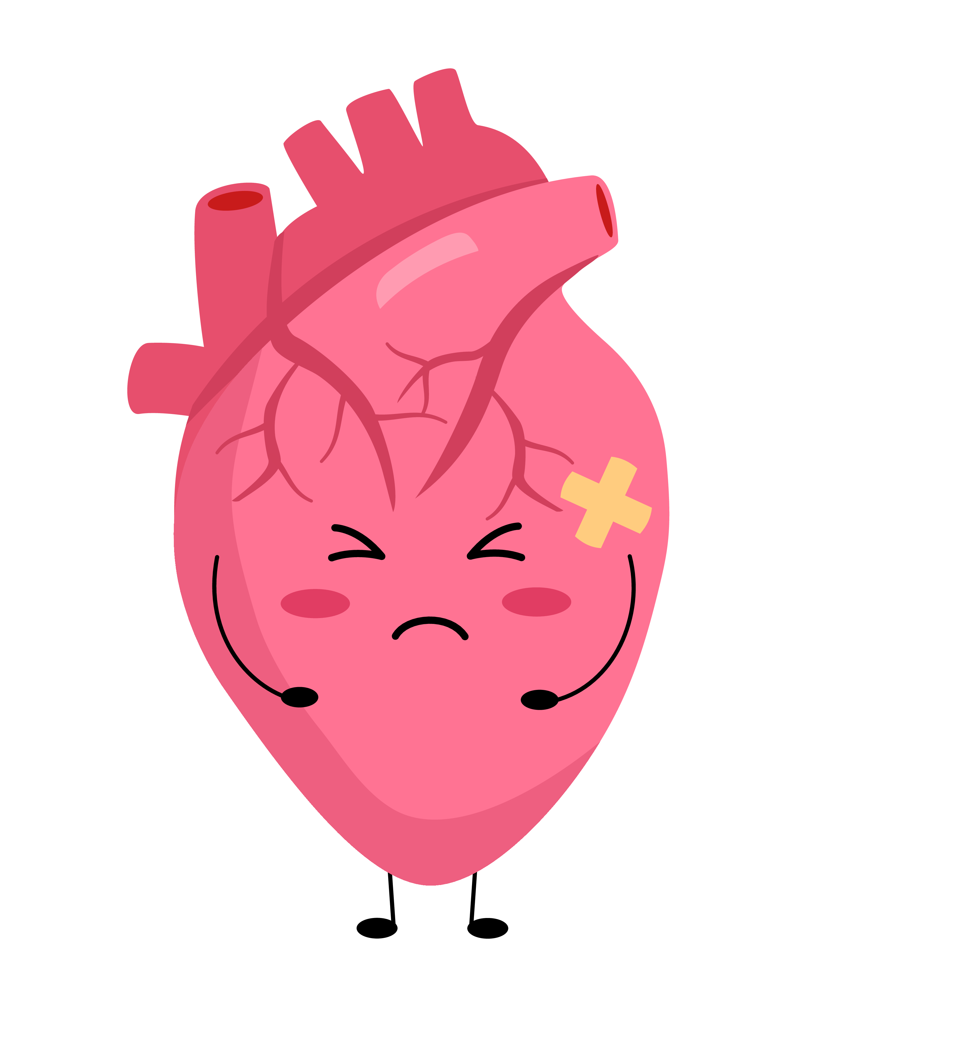
Quiz #4: What happens if blood vessels get squeezed like a straw?
Blood flows easily
Heart works harder
Nothing changes
Notes:
(Correct: b – Heart has to pump harder, which isn’t healthy!)

Slide 12
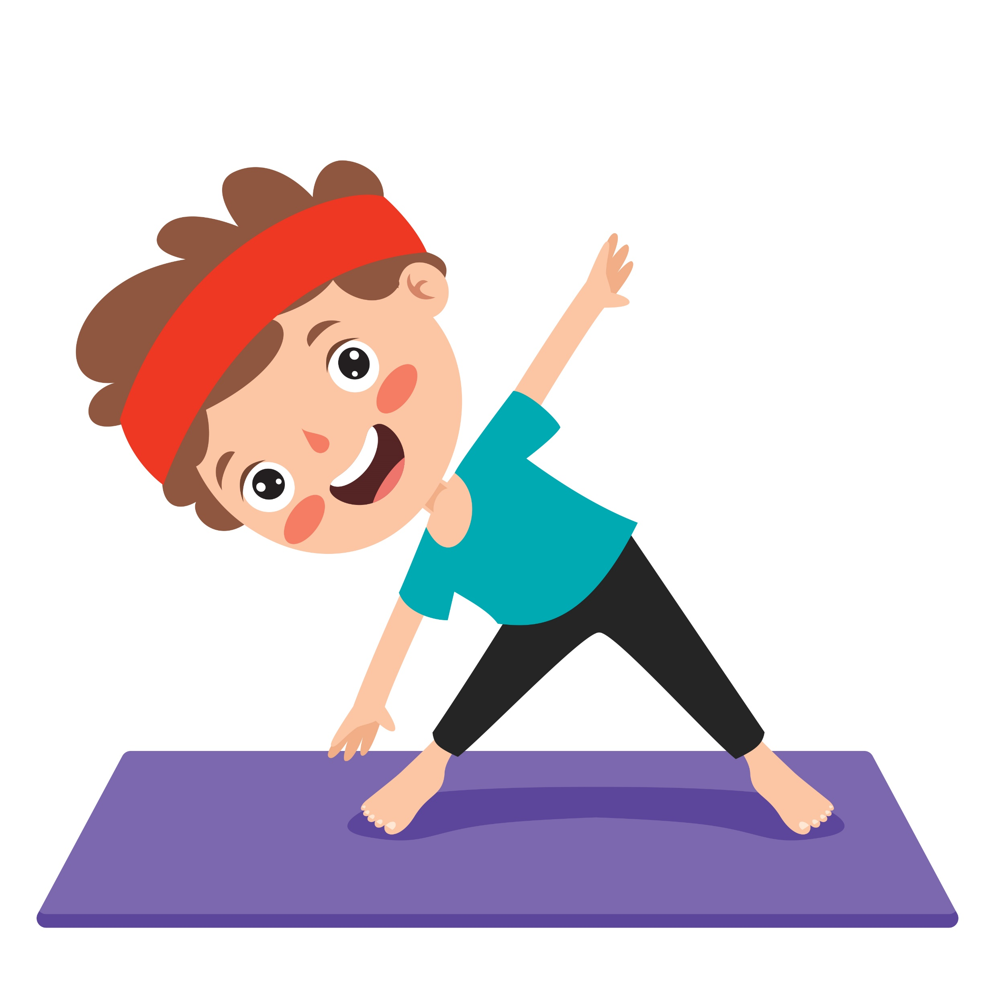

In Motion
Kids & teens: 60 minutes of activity daily.
Exercise = superpower for heart, brain, and bones.

Slide 13
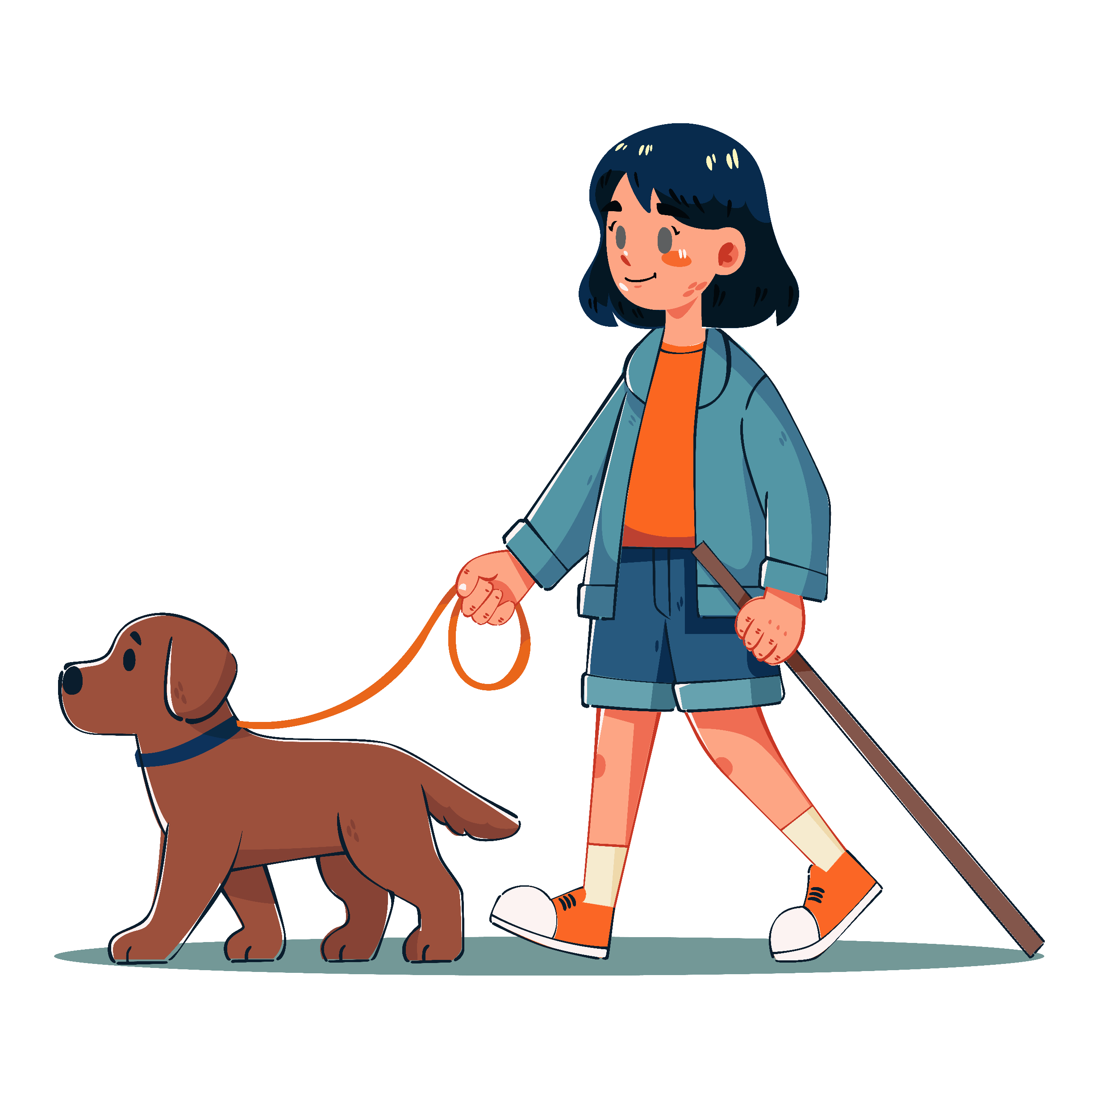
Quiz #5: Which of these counts as physical activity?
Dancing with friends
Riding a bike
Walking the dog
All of the above
Notes:
(Correct: d – All movement helps!)

Slide 14
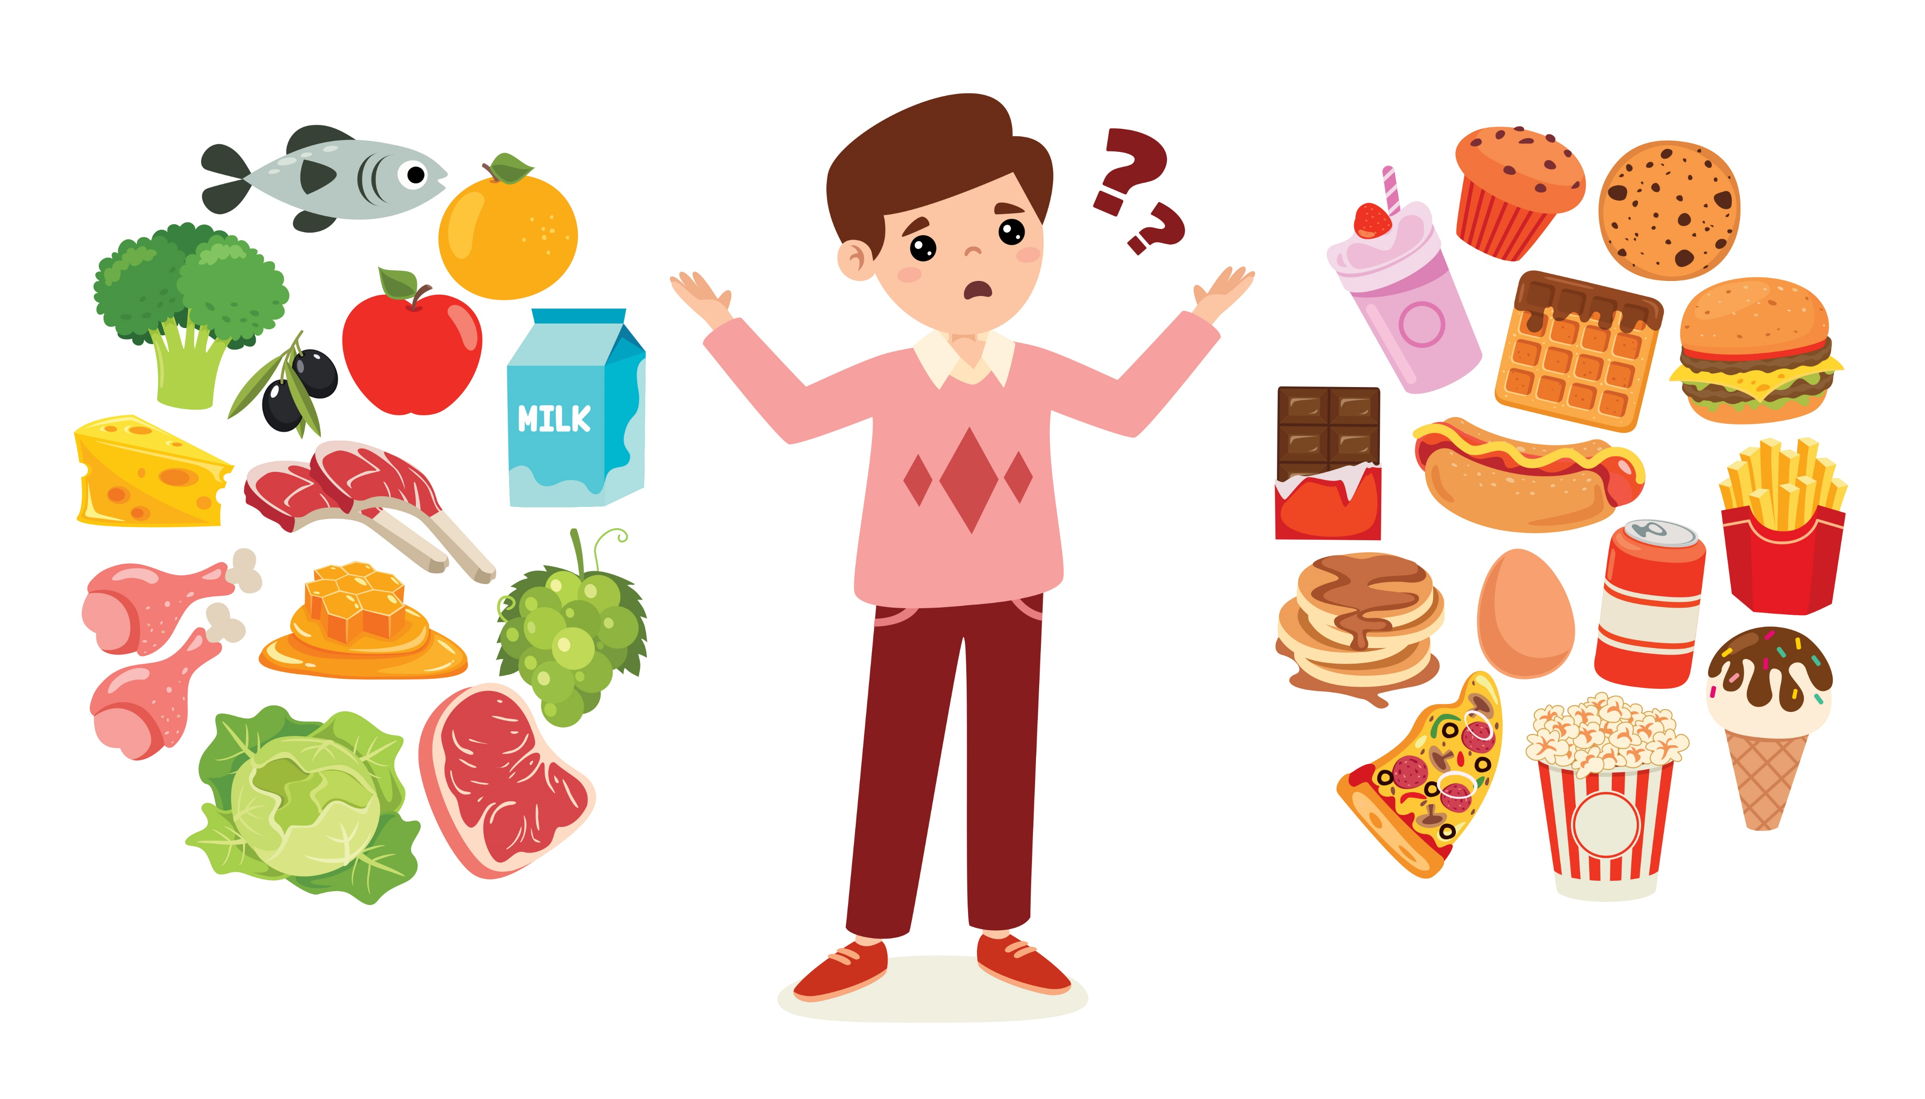
Tips for Everyday
Choices
Swap soda for water.
Pick fruit instead of candy.
Try kid-friendly recipes: recipes.heart.org.

Slide 15
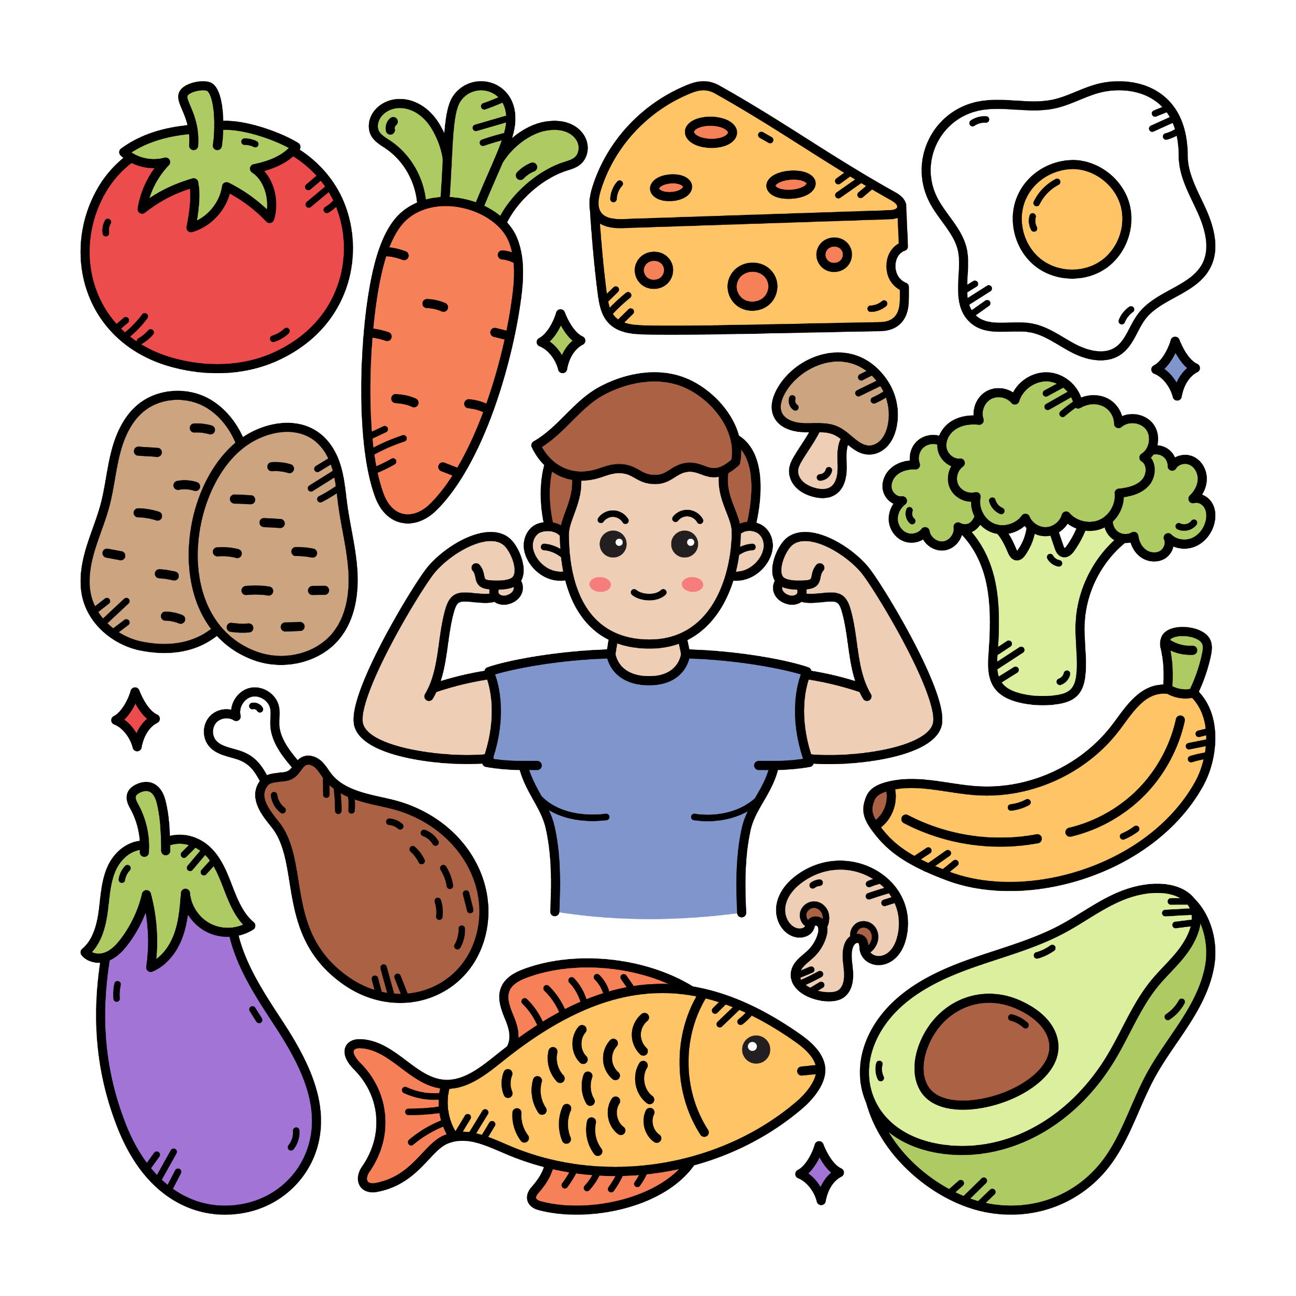
Wrap Up
Life’s Essential 8 = daily habits for a healthy heart.
Small choices add up.
You have the power to fuel your future!

